Slide 1
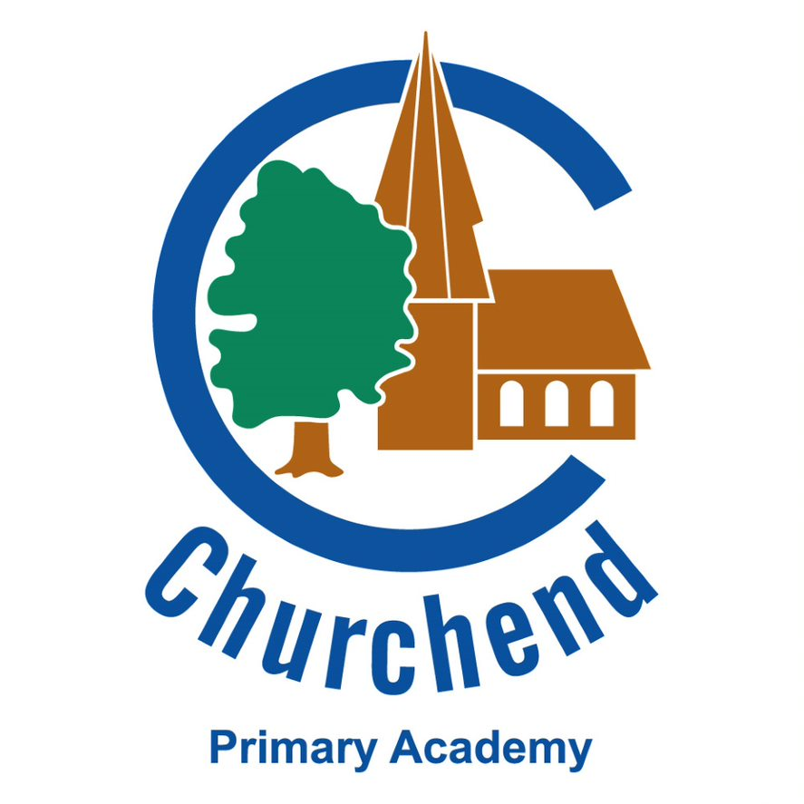
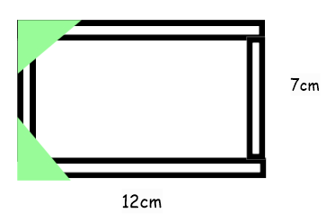
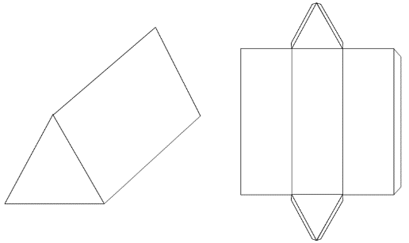
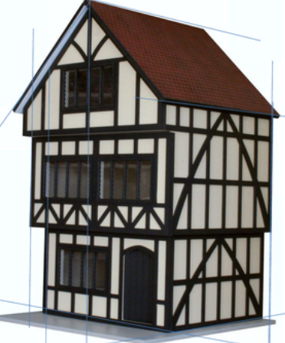
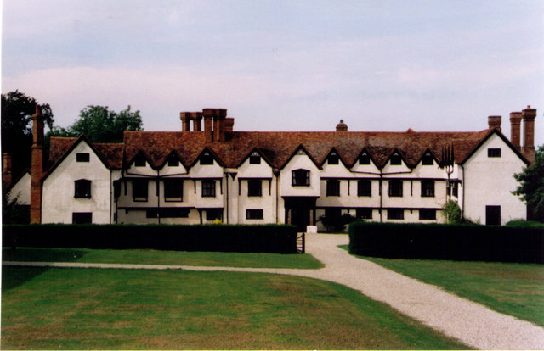
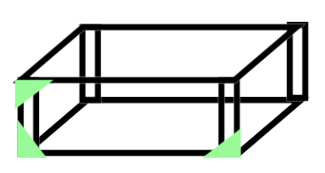
Tudor houses|DT |Year Five | Autumn Term 2
Key facts
1 | Tudor houses are well-known for their black timber (wood) and white walls.
2 | Many Tudor houses had an overhanging jetty.
3 | Glass was expensive and therefore only a few people could afford windows. Most people took their windows with them when they moved home.
Technical Knowledge
1 | Precisely cutting a variety of wooden beams to form the structure of the Tudor house.
2 | Holding a coping saw with a tight grip and use a gentle back and fourth motion due to the nature of the fine blade.
3 | Using jinks triangles to strengthen the joints where wooden beams meet at the base and on the edges.
4 | Designing a net using cardboard to form a secure triangular prism shaped roof.
Vocabulary
Join | a place where two things are fixed together
Jetty | Upper part of a Tudor house that overhangs
Timber | Wood used for building
Net | A 2-D shape used to form a 3-D shape when attached together
Symmetry | When opposite sides are equal
Evidence
 | Many buildings with a Tudor past still exist today. This includes places such as: Ufton Court (which is a large Tudor manor house) located in Berkshire.

