Slide 1

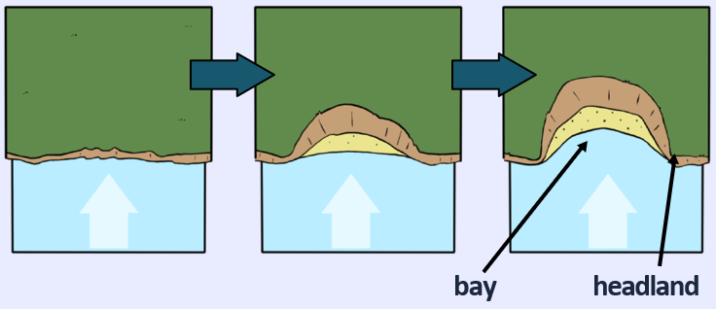
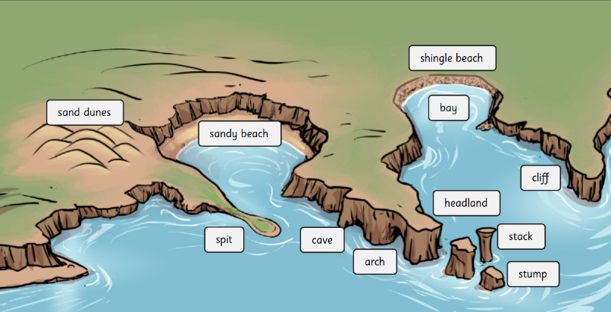
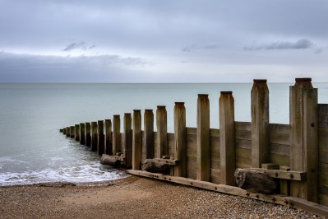
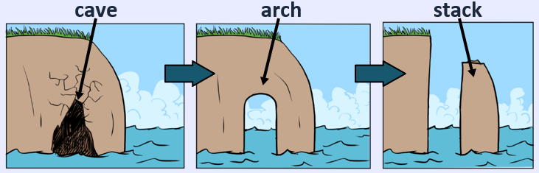
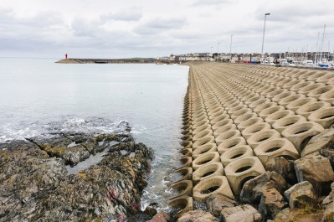
Geography – Coasts– Responsibility| Year Five | Autumn 1
Locational Knowledge
1 | Coasts are made of different rock types which affects its speed of erosion.
2 | Coastal areas are predominantly made up of residential and commercial land uses.
Human & Physical Geography
1 | Identify land uses in coastal areas.
2 | There are 4 types of erosion – hydraulic action, abrasion, attrition & solution.
3 | Coastal features are found along a coast. These include: bays, headlands, beaches, spits, sand dunes, rockpools, caves, arches, stacks, stumps.
4 | People and wildlife is affected by erosion.
5 | Coastal defences cannot prevent erosion but it can slow it down. These coastal defences have advantages and disadvantages.
Vocabulary
Coasts | The place where the land meets the sea or ocean.
Erosion | The process of natural forces wearing away rock or soil.
Deposition | The act of waves leaving behind sediment on the coastline.
Sediment | Small particles of rock.
Headland | A cliff that sticks out into the sea.
Stack | A tall, isolated column of rock.
Arch | A rock formation resembling a bridge with a curved opening.
Bay | A curved body of water surrounded by land on three sides
Coast defences | Man-made structures put in place to slow down erosion.
Cliffs | Steep, towering rock formations along the coastline.
Place Knowledge
1 | Brighton is a popular coastal area.
2 | Old Harry’s Rocks in Dorset is an example of where erosion has created stacks and stumps.
3 | Holderness & Happisburgh are areas of the UK which suffers from fast erosion. This is due to powerful winds and rock types in these areas.
Geographical Skills & Field work
1 | Use aerial images and plan perspectives to recognise landmarks, land uses and basic human and physical features.
2 | Use maps to identify patterns between rock types & areas of fast erosion.

