Slide 1

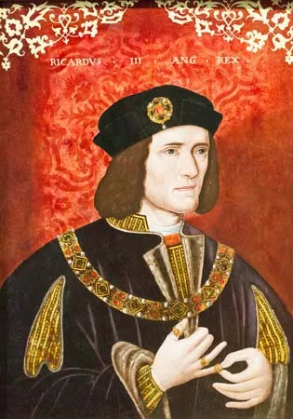
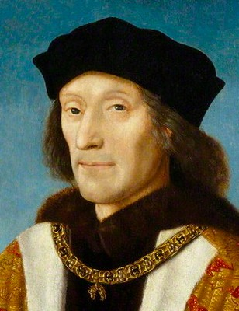
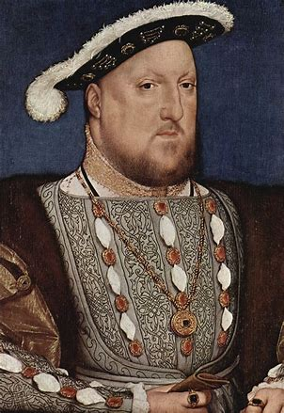

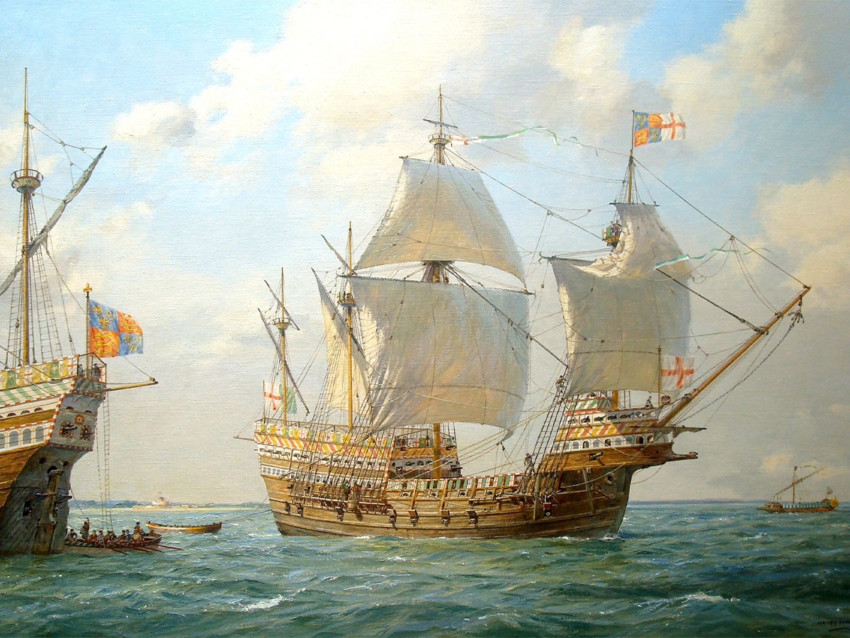
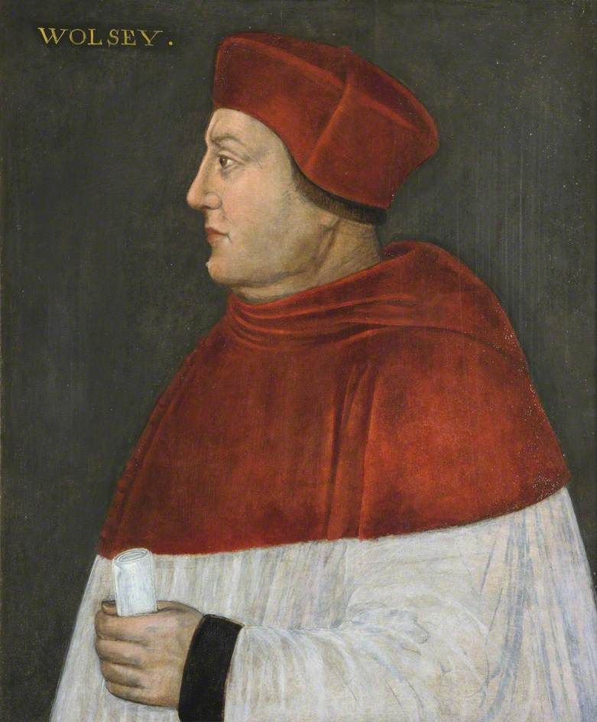
The Tudors| History | Year Five | Autumn 2
Vocabulary
Monarch | The king or queen of a country
Reformation | Changes to the Catholic Church that led to the setting up of the Protestant Church
Alliance | Groups working together
Heir | Someone who will inherit a title or property
Rebellion | Violent action to change a countries political system
Parliament | A group of people who make or change laws
Military | Armed forces of a country
Protestant | The second largest branch of Christianity that became separate from the Catholic Church
Reign | The time period a King or Queen is ruling
Legacy
Henry VIII's decision to break with the Catholic Church in Rome is still a significant point in history today. In 1534 the Pope had refused to allow Henry to remarry. Henry remarried anyway (to the second of his six wives) and named himself the head of the Protestant Church of England. This started the English Reformation, during which the power of the Roman Catholic Church was challenged.
The consequences of this were far reaching and divided Catholics and Protestants even further, in Britain and Europe.
Although still very much in power, the Tudors, notably Henry VIII, recognised the need to involve Parliament in important decisions, thus helping to develop the system of government we understand today.
It was also a time of global exploration and popular entertainment. Famous explorers returned with unusual gifts from the New World and writers, such as Shakespeare, were filling theatres with their plays.
Key People & Places
Richard III – Head of the House of York, Richard III seized the throne from his nephews by putting them in the Tower of London. The nephews mysteriously then disappeared allowing Richard III to take the throne. Richard III fought in the Battle of Bosworth and was killed resulting in him losing the throne.
Henry Tudor – Head of the Lancaster House. Henry Tudor gained the throne when he defeated Richard III in the Battle of Bosworth, starting the Tudor Period. Henry VIII married Elizabeth of York from the House of York reuniting the two houses and creating the Tudor Rose.
Henry VIII – Son of Henry VII. He had many wives and many met their fate. He started the reformation against the Catholic Church.
Cardinal Wolsey – King Henry VIII’s most trusted advisor.
Tudor Rose
Mary Rose
1485
1485-1509
1509-1547
1553-1558
1588
1603
Battle of Bosworth Field; Henry Tudor became Henry VII
Henry VII's reign
Henry VIII's reign
Mary I's reign
England defeated the Spanish Armada under Elizabeth I reign
Elizabeth I died and James Stuart became king

