Slide 1

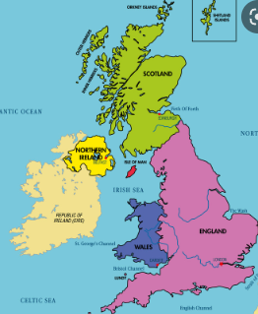
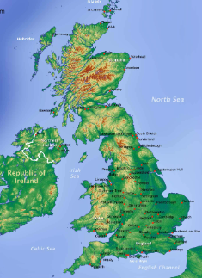
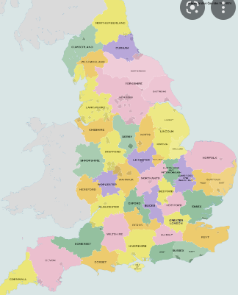
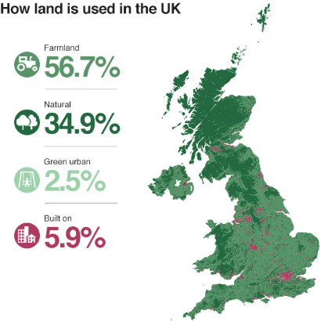
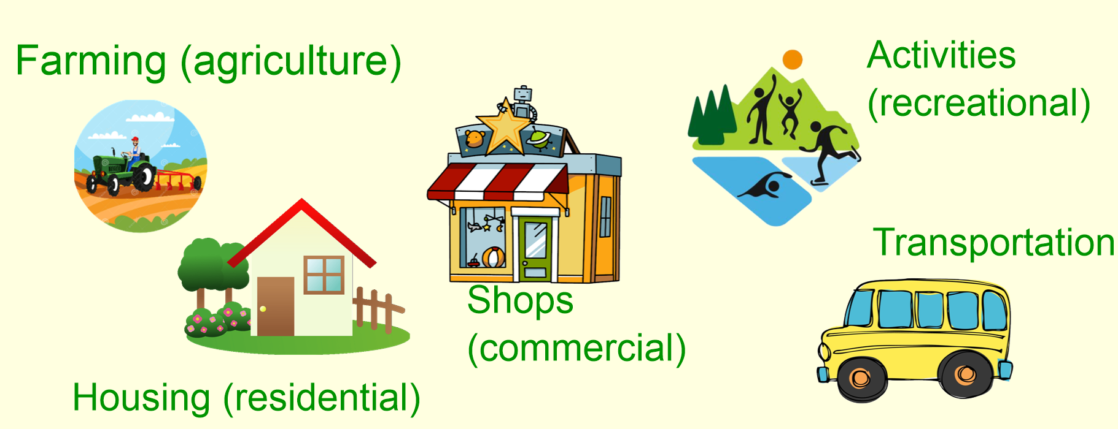
Geography – Land Use in the Local Area – Settlements | Year 4 | Autumn 1
Locational Knowledge
1 | The UK is part of Europe which is made up of 50 countries.
2 | The UK is made up of 4 countries – England, Ireland, Scotland and Wales.
3 | There are 5 different environmental regions which are commonly seen across the world: urban, coasts, grasslands, mountains & forests.
Human & Physical Geography
1 | Land across the world is used in different ways. This is called land use. There are 5 different land uses: commercial, agriculture, residential, transport, recreational.
2 | There are different settlements which range in size: village, town, city, county, country.
Vocabulary
Political map | A map which shows countries and the main cities within them. They show the boundary between one country and another.
Topographical map | A map which shows the elevation of land through colour.
Environmental region | An area with specific environmental features such as a coastal region will have the sea, sand/pebbles and cliffs.
Land use | When an area is used for a specific purpose to meet the wants and needs of people.
Settlement | A place where people live, this could be with very few people like a village, or larger communities like a town.
Counties | Territories which make up one place.
Geographical Skills & Field work
1 | Use fieldwork to observe, measure, record and present the human and physical features in the local area using a range of methods, including sketch maps, plans and graphs, and digital technologies.
2 | Use maps, atlases, globes and digital/computer mapping to locate countries and describe features studied.
Place Knowledge
1 | Tilehurst is a suburb in the town of Reading which is in the county of Berkshire.
Political map
Topographical map
Counties of England

