Slide 1

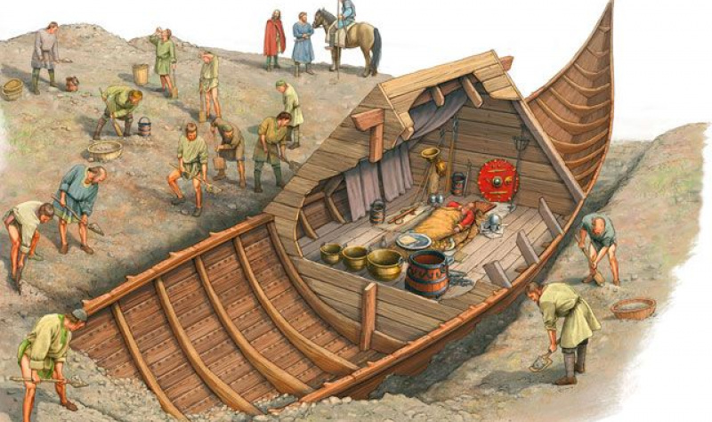
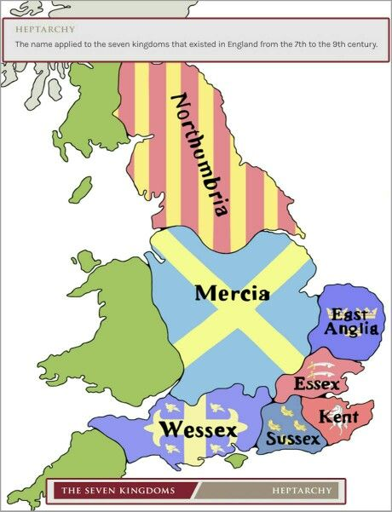
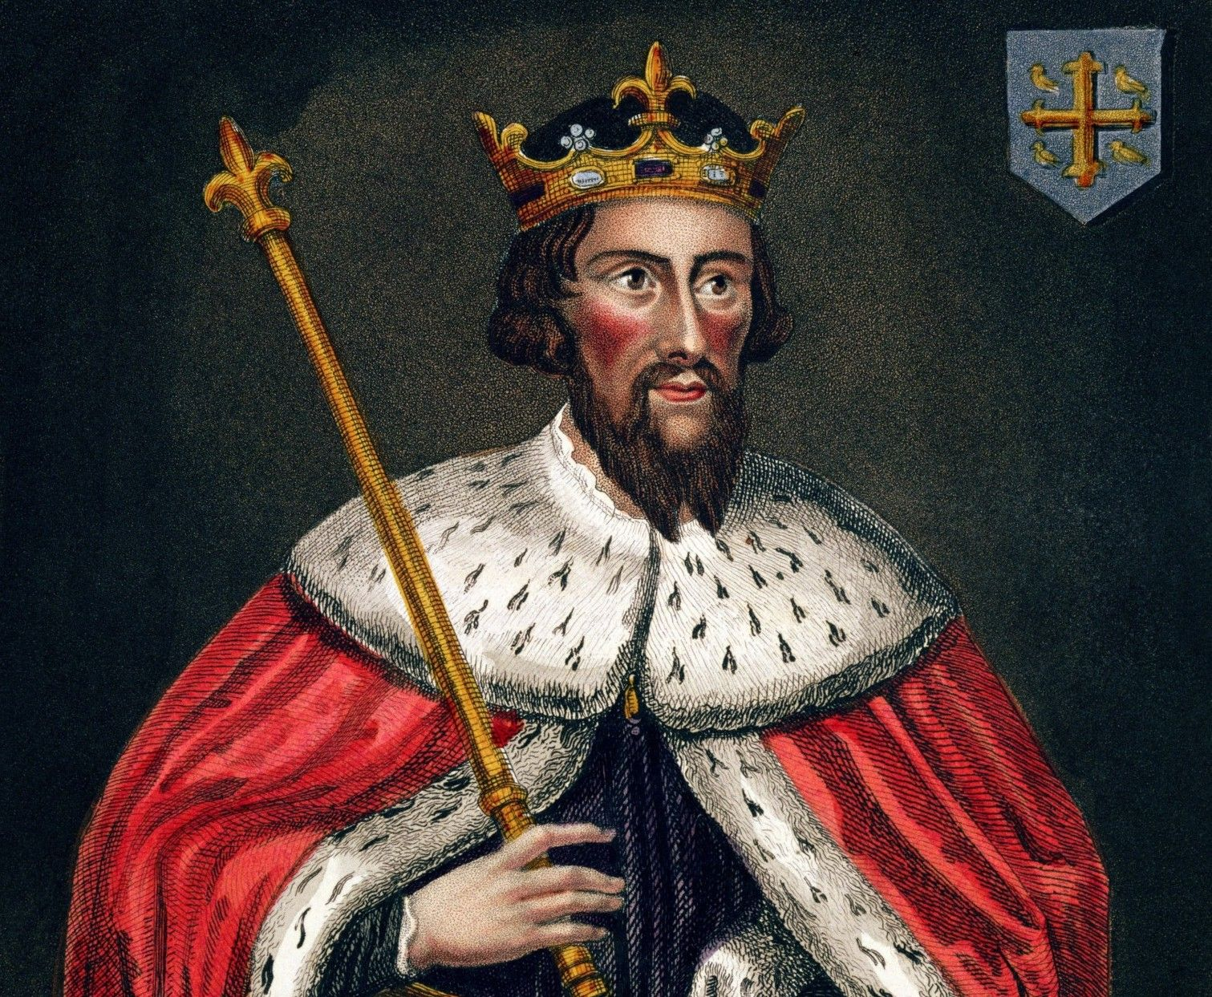
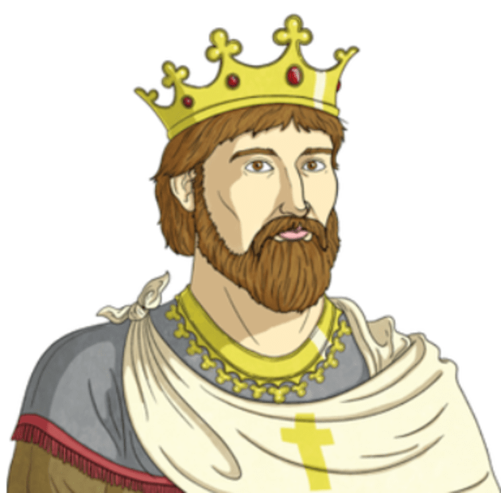
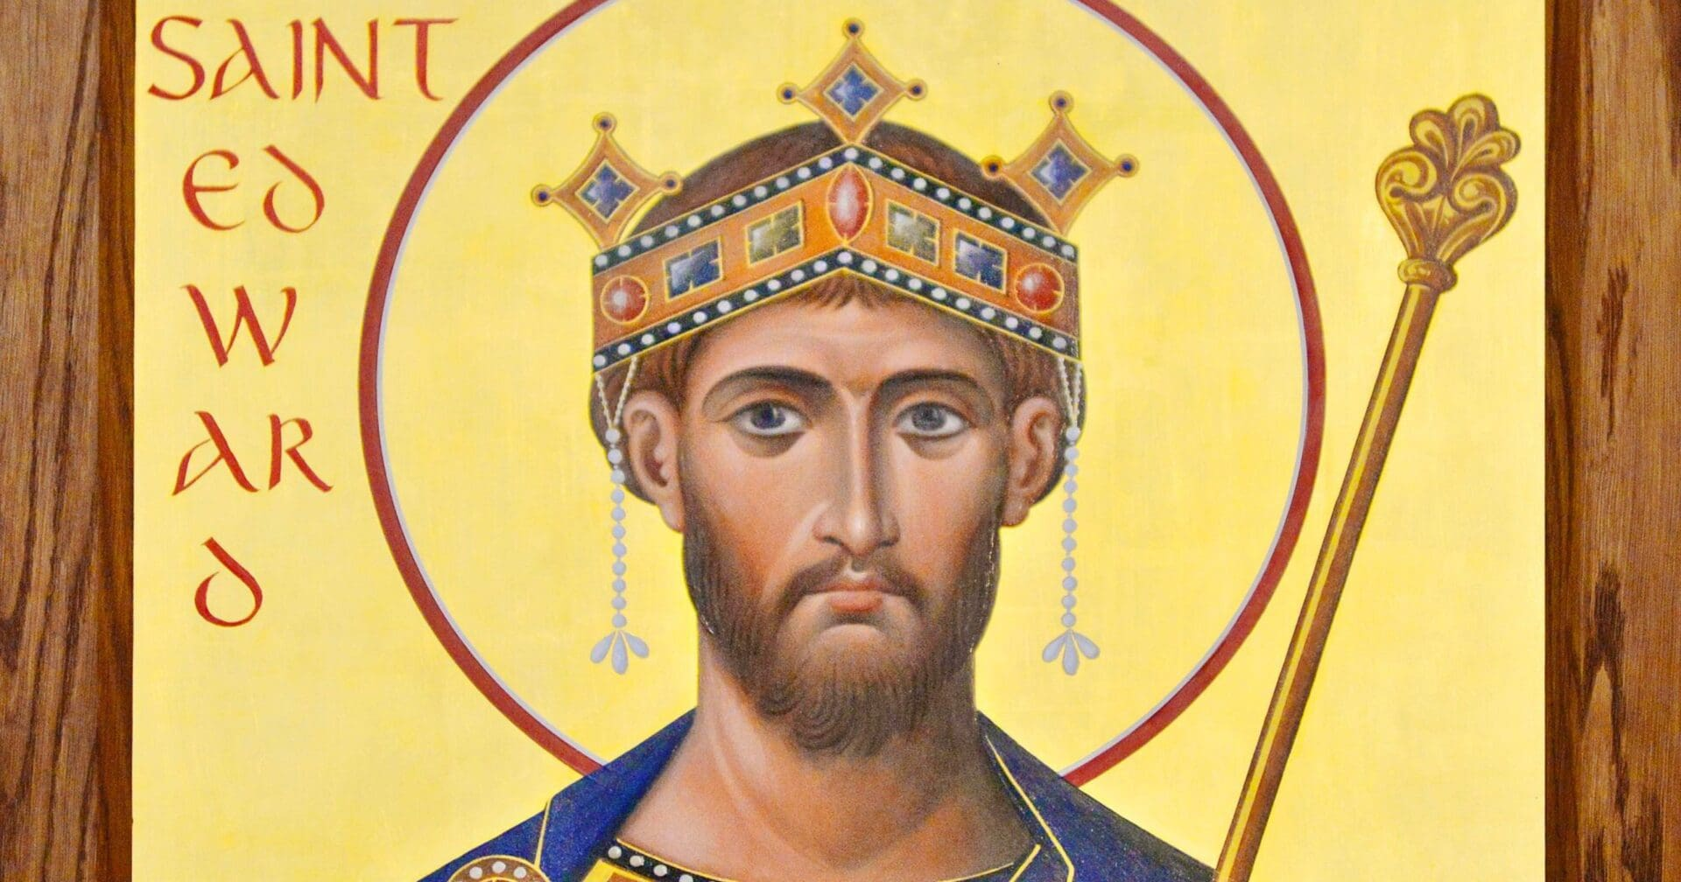
Vocabulary
Push factors | Reasons why the Anglo-Saxons left their homelands.
Pull factors | Reasons why the Anglo-Saxons wanted to settle in Britain.
Urn | Decorated pottery used for burial in Anglo-Saxon England.
Settlement | A place where people move to or newly settle.
Archaeologist | A person who studies human history by analysing artefacts.
Settle | To live and take up residence.
Saxon hoard | The largest collection of Anglo-Saxon gold and silver ever found.
Invade | An armed force enters a country or region in order to occupy it.
Pict | A group of people who lived in what is now northern and eastern Scotland.
Sceptre | A rod held by a king or queen on special occasions to show that they are royal.
Anglo Saxons| Year Four | Autumn 1
Key People & Places
Sutton Hoo – a site of two Anglo-Saxon cemeteries. It is often known as England’s Valley of the Kings and the ship burial found in the King’s Mound is the richest burial ever found in northern Europe.
East Anglia – an area in the East of England. It was one of the kingdoms of Anglo-Saxon England.
King Alfred – reigned from AD 871-899 – known as Alfred the Great, he fought the Vikings and then made peace so that English and Vikings settled down to live together.
King Athelstan – reigned from AD 925-939 – Athelstan was Alfred the Great’s grandson. He was the very first ‘King of all England’.
Edward the Confessor – reigned from AD 1042-1066 – the last of the Anglo-Saxon kings of England. He was known for his religious faith.
Invasion/Migration
The Anglo-Saxons were a group of farmers and warriors.
They lived in Britain over 1000 years ago and were made up of three tribes: the Angles, Saxons, and the smaller Jute tribe.
There were many reasons why they were attracted to Britain: Romans leaving; a better climate; fertile land for farming and a lack of food in their home countries.
The British fought hard against the Anglo-Saxons but by about 600AD they had either been forced to escape or had been taken as slaves. Those who escaped retreated mainly to Wales and Cornwall which never came under Anglo-Saxon rule. The rest of Britain was divided into 7 kingdoms: 1.Northumbria, 2.Essex, 3.Wessex, 4.Sussex, 5.Mercia, 6.Kent, 7.East Anglia
The Anglo-Saxons settled in many different parts of the country – the Jutes ended up in Kent, the Angles in East Anglia, and the Saxons in parts of Essex, Wessex, Sussex and Middlesex.
They settled in places near to rivers or the sea, which could be easily reached by boat.
400 AD
625 AD
731 AD
899 AD
1066 AD
The Romans leave and the Anglo Saxons arrive.
King Raewald is buried at Sutton Hoo.
St. Bede writes ‘The Ecclesiastical History of the English People’.
King Alfred dies.
Battle of Hastings - Norman rule.

