Slide 1

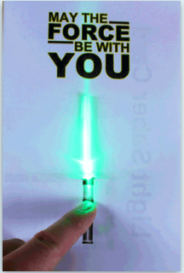
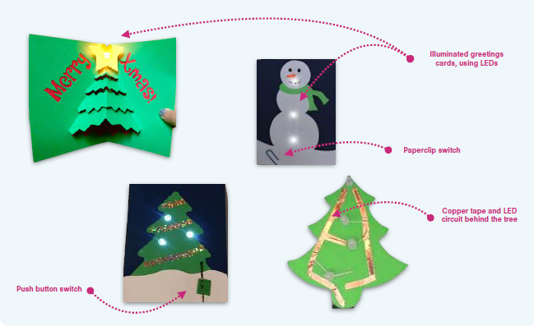
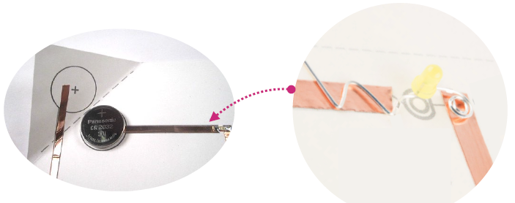
Design and Technology: Electrical Systems| Year Four| Autumn
Key Facts
1 | Electrical connections between LEDs, switches and batteries may be made with copper tape, a conductive material that acts in the same way as wire.
2 | Designers need to practise making things until their hands and fingers do things automatically, without much thinking. This is called fluency. By practising making copper tape circuits with switches you will become fluent in creating switches and circuits.
3 | Using LEDs and artwork in different ways can add interesting effects and enhance your products.
4 | Exploded diagrams with annotation allow designers to clearly communicate how to make a product reliably that works.
Technical Knowledge
1 | An electric circuit allow electricity to travel along a path. The electric circuit includes a battery, an LED and the connecting wires.
2 | Before you attach your LED to your circuit you need to determine which is the + (positive) and which is the – (negative) side. The + side needs to be attached to the + side of the cell and the – side needs to be attached to the – side of the cell for the LED to turn on. Generally, the longer wire on an LED is +.
3 | ‘battery’ means a number of cells together; ‘cell’ is the correct term for a single source of power.
4 | A switch allows the circuit to be broken to stop and start the flow of electricity. Switches may be made by laying out circuits of copper tape in different ways. Folded paper or other components can be used to break or complete a circuit.
Vocabulary
Circuit | A path along which electricity flows.
LED | Light Emitting Diode – a type of light bulb
conductive | A material that is conductive Allows electricity to pass through it
adhesive | Able to stick to a surface
illuminate | To light up
enhance | Improve something’s value, quality or attractiveness
prototype | a first, experimental model of your design to test out your ideas
exploded diagram | a diagram that is enlarged to show more detail
Inspiration | Where you got your ideas from
user | The person the product is designed for
purpose | The reason something is made

