Slide 1

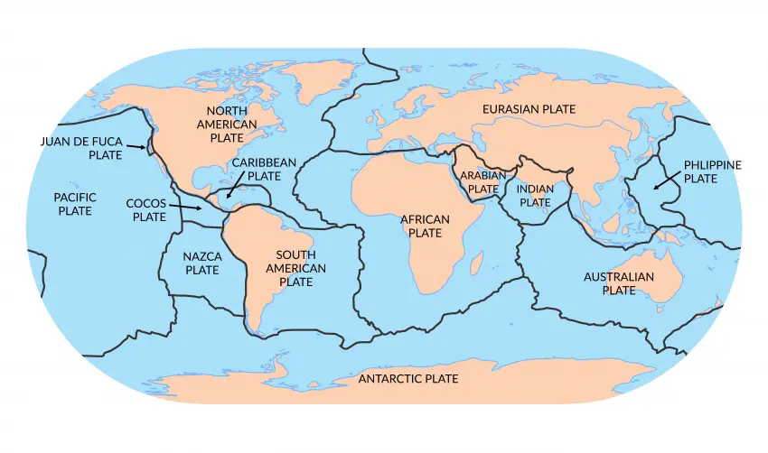
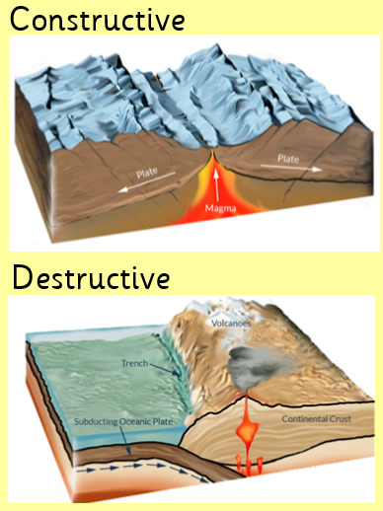
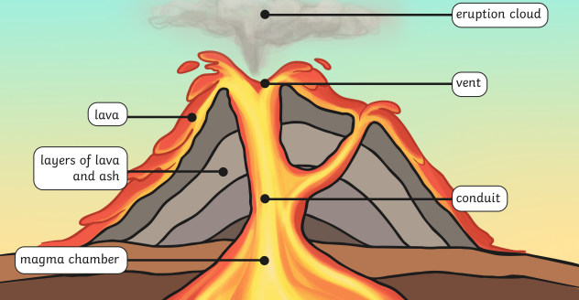
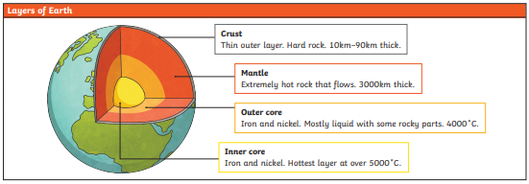
Geography – Volcanoes– Settlements| Year Four | Spring 1
Human & Physical Geography
1 | The Earth is made up of 4 layers: crust, mantle, outer core & inner core. The crust is made up of many pieces that fit together like a jigsaw. These are called tectonic plates.
2 | Tectonic plates move between 1-10cm a year. They can rub together (transform boundaries), apart from each other (divergent) and towards each other (convergent). When they diverge or converge they can create volcanoes.
3 | In a volcano there is a magma chamber, vent & conduit.
Vocabulary
Active | A volcano that may erupt in the future
Dormant | A volcano that has not erupted recently but could erupt again in the future
Eruption | When a volcano erupts it sprays out hot molten rock called lava
Extinct | A volcano that is not likely to erupt in the future
Lava | The very hot liquid rock that comes out of a volcano
Magma | Molten rock that is formed beneath the earth’s crust
Tectonic plate | These are pieces of the rocky outer layer of the earth known as the crust
Volcano | A vent in the earth’s crust where lava, steam and ash comes out during an eruption
Locational Knowledge
1 | The Ring of Fire is located in the Pacific Ocean. It is a hotspot for tectonic activity and 75% of active volcanoes are found here.
Place Knowledge
1 | There are advantages and disadvantages to living in a volcanic area.
Geographical Skills & Field work
1 | Use maps, atlases, globes and digital/computer mapping to locate countries and describe features studied.

