Slide 1

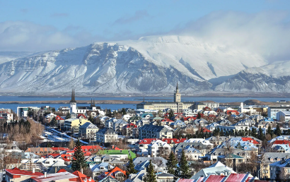
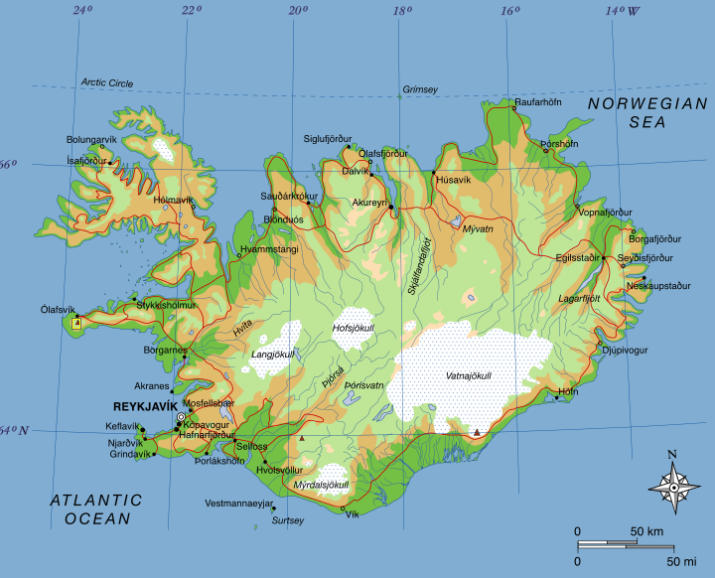
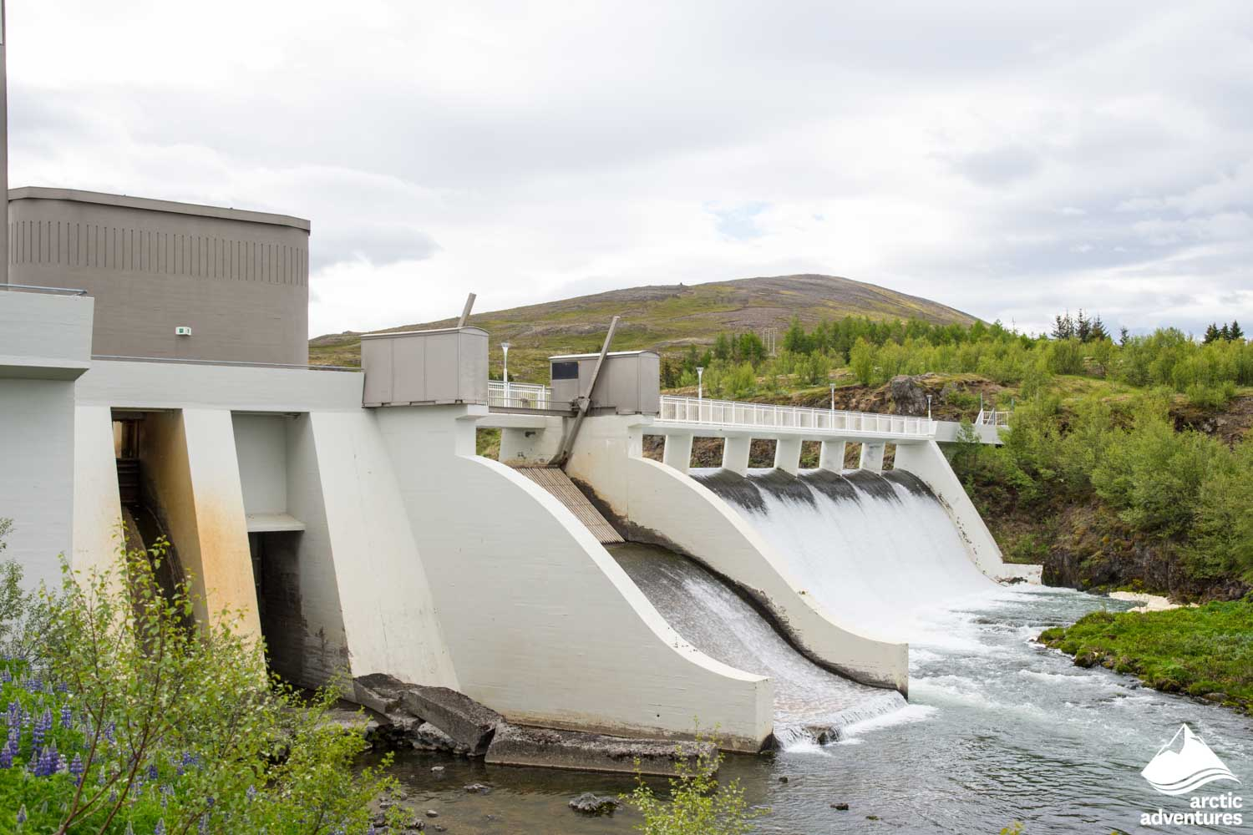
Geography – Iceland– Settlements| Year Four | Spring 2
Locational Knowledge
Iceland is located in Northern Europe.
There are many environmental regions found in Iceland: coastal, urban, mountains, desert, ice field (glacier), forest, grassland and lava field.
Human & Physical Geography
Iceland is known as ‘The land of fire and ice’ due to extreme contrasts in its landscape.
Iceland is home to many active volcanoes but is also a country often covered in snow and ice. Iceland is a popular tourist destination spot because of its physical features it has to offer such as black volcanic beaches, dormant volcanoes and exploding geysers.
As it is such a northernly country, Iceland experiences long summer days of almost 24 hours of daylight in contrast to their very short winter days where they receive only a few hours of daylight.
99% of Iceland’s energy comes from renewable energy which helps fight climate change while only 43% of the UK’s energy is renewable.
Vocabulary
Physical features | A feature in the environment which is natural and not been made by humans for example geysers, and volcanoes.
Human features | A feature in the environment which is made by humans for example houses and shops.
Population density | A number which indicates how empty or crowded an area is.
Environmental regions | It is a large space of land which is different to others in regards to its physical features, sometimes it is defined by its climate too.
Sustainable | To carry out an activity that causes little to no harm to the environment to save it for future generations.
Renewable energy | Energy that comes from natural sources such as sunlight and wind therefore is sustainable and will not run out.
Hydro-electric Power (HEP) | Energy created by moving water.
Geothermal energy | Heat taken from the Earth’s core transferred into energy.
Place Knowledge
Iceland has a small population and is a small island at about half the size of the UK. Despite its small size a lot of the Iceland’s land is uninhabited. Over 80 percent of its land has a terrain that is makes for difficult living such as it’s lava fields and glacier ice fields.
More than 60% of Iceland’s total population live in Iceland’s capital city Reykvijik.
 | England | Iceland
Population | 56 million | 380,500
Size of area | 243,610km | 103,200km
Climate | Winter lows of Summer highs of | Winter lows of –3 Summer highs of 15
Daily hours of daylight (winter) | 8 | 4
Daily hours of daylight (summer) | 15 | 22

