Slide 1
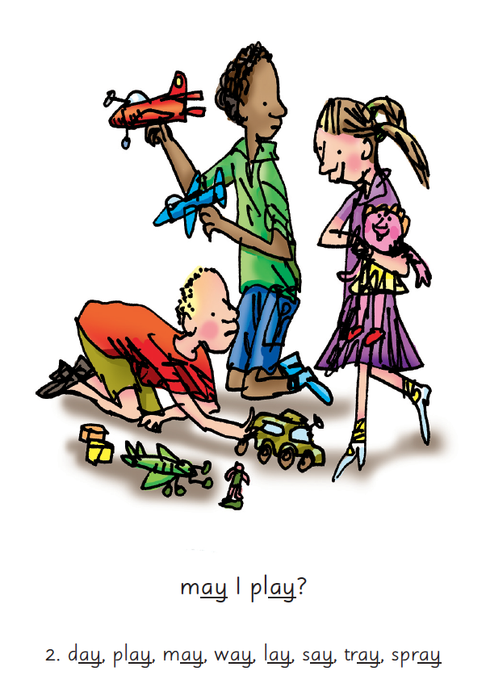


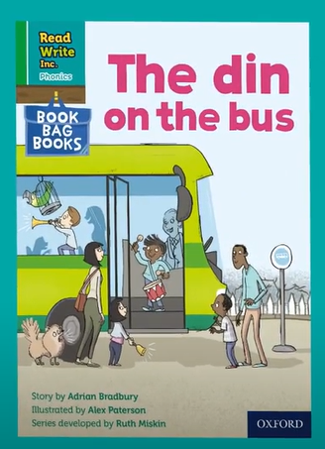

Introduction to book bag books

Slide 2
At Churchend Primary Academy we want to instil a love of reading in all our pupils and believe that reading is the key to the curriculum. Following the most recent government guidance and evidence-based research, we have made some changes to the books that we use to teach reading and this will also affect the books that we send home with the children, to practice and consolidate their developing reading skills.

Slide 3
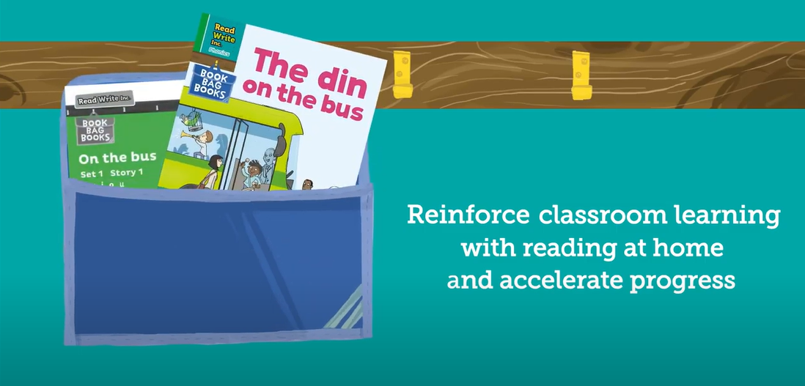
At the academy we continue to use the Read Write Inc phonics programme to teach and develop children’s reading. Home reading books will continue to be sent 3 times a week (Mondays, Wednesdays and Fridays). The focus of these books will be to reinforce teaching in school and build upon children’s confidence to read independently.

Slide 4
What goes home when
Monday – Read Write Inc Storybook, containing sounds and words the children know. This is a Storybook they have read at school. Please don’t think that these books are too easy. Children enjoy re-reading stories they know well. Their speed and understanding improves on every read.
Wednesday – Read Write Inc Book Bag Book, matched to the Storybook children read in school and used for extra practice. They include many of the same reading activities that we use in class and include parent guidance.
Friday – A picture book chosen by your child to share with you. Read these stories to children or encourage them to retell the story by looking at the pictures. They are not expected to read the story themselves. One of the most important things you can do as a parent at home is read to your child. Loving stories is important because children who love stories want to read stories for themselves. Children who read a lot become better readers.

Slide 5
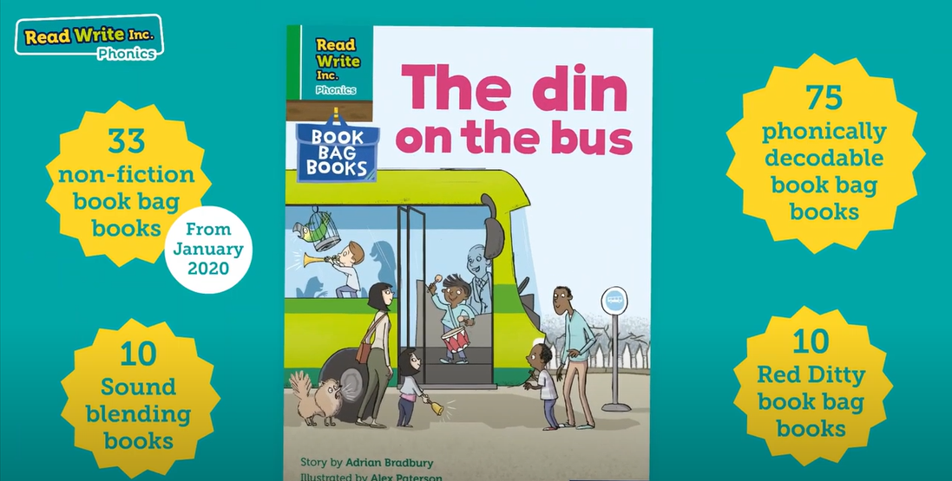
Book Bag Books

Slide 6
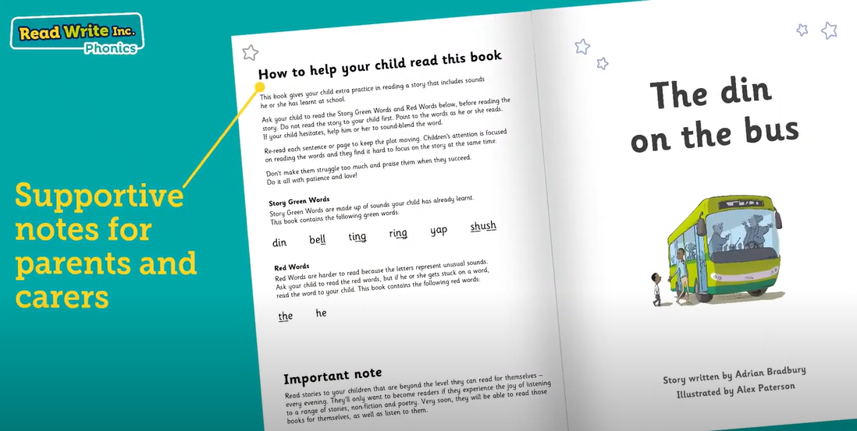
Inside cover

Slide 7
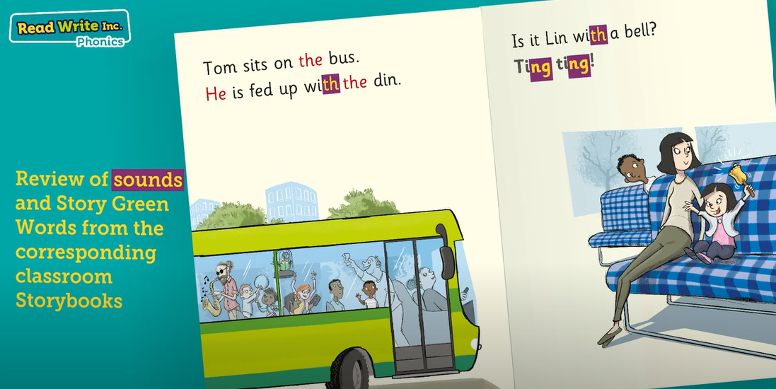
Reviewing sounds

Slide 8
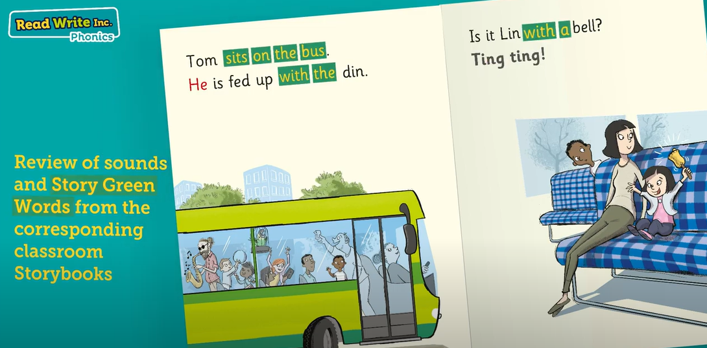
Reviewing words

Slide 9
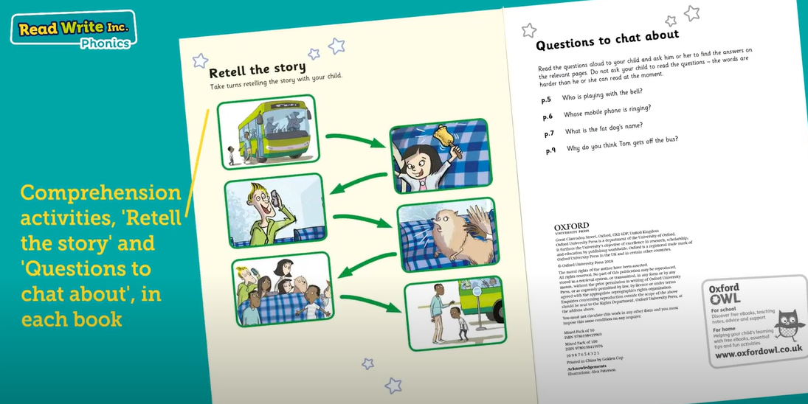
Comprehension and Questions

Slide 10

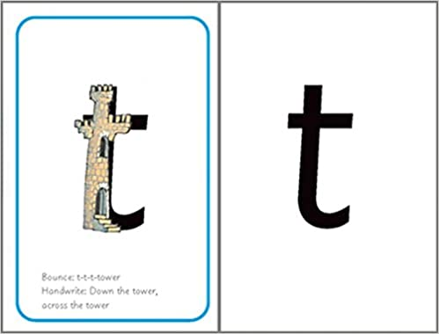

Sounds + blending = reading
+
+
Notes:
Today I want to help you understand how your child is learning to read words in Read Write Inc. Phonics by blending sounds together:
Alongside teaching children sounds, we teach them to blend sounds to read words e.g. s-a-t, sat.
We use Fred Talk to help children read.

Slide 11


‘Special Friends’, ‘Fred Talk’, read the word
Notes:
Then children practise reading these sounds in words using the routine ‘Special Friends’, ‘Fred Talk’, read the word’.
They spot the ‘Special Friends’ first, then Fred Talk to read the word.
For example, ‘ay’, s-p-r-ay, spray.

Slide 12

Fred Talk routine
Say the word in sounds as Fred e.g. c-a-t.
Ask your child to repeat. Can they ‘jump-in’ with the whole word?
Say the word in sounds followed by the whole word e.g. c-a-t, cat
Ask your child to repeat
Notes:
Fred Talk follows a consistent routine:
Say the word in sounds as Fred e.g. c-a-t. Ask children to repeat. Pause to allow children to ‘jump-in’ with the whole word.
Say the word in sounds followed by the whole word e.g. c-a-t, cat. Ask children to repeat.

Slide 13


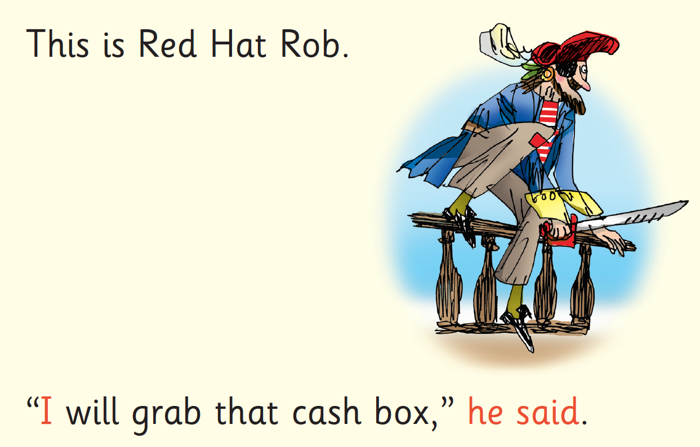
Red Words
Notes:
Some words are ‘tricky’ because they contain letters that don’t match the sounds the child has been taught.
For example, ‘said’ has ‘ai’ making an ‘e’ sound.
We teach these common exception words as Red words.
In the early Storybooks, these words are printed in red text.
Remind your child not to use Fred Talk to read Red words but instead to stop and think. Tell them the word if needed.

Slide 14
Let's read it again and again!
At Churchend the children focus on one RWInc book for three or four days this allows different skills to be developed.
Read 1 focusses on accuracy, this stage takes lots of concentration!
Read 2 begins to develop fluency
Read 3 works on comprehension
Read 4 is for enjoyment
Notes:
In our school, children read each Read Write Inc. Storybook three times in class with their partner.
Re-reading the same book helps children to become confident readers. Each time they re-read, they build their fluency/speed and comprehension.
They love reading and want to read because they can read all of the words in the Storybook.
We set a focus for each re-read in school.
(Click) The first read focuses on reading every word accurately.
(Click) The second on reading the story more quickly.
(Click) The third read on comprehension - understanding what they read.
Then your child brings the same book home to read and enjoy with you again and again at home.
It’s ‘three with me, four at home.’
We do not send stories home the children cannot read because we always want them to be set up to succeed in their reading.
We want to make sure they enjoy reading so that they want to read.
The more they read, the faster progress they will make.

Slide 15
What can you do?
Listen to your child read the same Storybook again and again
Encourage them to use ’Special Friends’, ‘Fred Talk’, ‘read the word’
Discuss the story and encourage their storyteller voice.
Please ensure that your child has his/her reading book in school on the book changing days, as they will be needed to distribute to other children, ensuring all pupils read a book at the appropriate level to consolidate skills and give them confidence to become fluent, independent readers.
Notes:
Provide copies of ‘Reading at Home Booklet 1 or 2’ from Oxford Owl.
Booklet 1 is sound groups and Ditty/ Red Groups and Booklet 2 for Green – Grey Storybooks.

Slide 16
What happens after RWInc?
Once children have completed the Read Write Inc phonics programme, they will bring home a range of reading scheme books, matched to their reading level and ability on a Monday and Wednesday. They will continue to bring home a book of their choice to share with you on a Friday.

Slide 17
What makes a good reader?
Reading is a product of 2 skills:
word reading (decoding)
reading unfamiliar words by using sounds and blending them together
reading familiar words accurately and silently
language comprehension
The way in which we make sense of words, sentences and the wider language that we hear or read.

Slide 18
What makes a good reader?
Developing fluency
Fluent decoding enables children to understand what they read.
Fluency is a combination of:
  accuracy
  speed
  Accuracy is when decoding becomes automatic.
  Speed is the pace that allows children to understand what they read (not how fast they read).
  Both accuracy and speed are essential.

Slide 19
Language Comprehension
Children gain good levels of language comprehension through:
daily conversations
listening to stories and rhymes
engaging in play and practical activities
reading independently
Questioning children will support them to understand what they hear or read.

Slide 20
VIPERS questions
Vocabulary = Draw upon knowledge of vocabulary in order to understand the text.
Infer = Make inferences from the text.
Predict = Predict what you think will happen based on the information that you have been given.
Explain = Explain your preferences, thoughts and opinions about the text.
Retrieve = Identify and explain the key features of fiction and non-fiction texts such as: characters, events, titles and information.
Sequence = Sequence the key events in the story.

Slide 21


What is the Phonics Screening Check?
A word-reading test at the end of Year 1
Children read 40 words (20 real words and 20 nonsense)
Notes:
Children complete a word-reading check at the end of Year 1 so that parents can be confident their children are being taught to read successfully.
Children read 40 words. It takes between two and five minutes.
If they do not manage to read 32 of the words, they are given extra support, and repeat the check at the end of Year 2.
It means that all children will be able to read accurately before they begin Year 3.
In our school, we aim to make sure that every child learns to read accurately by the end of Year 1 so they are set up for success in school and in life.
As soon as we spot a child who needs extra practice learning to read sounds and words, we teach them one-to-one for a few minutes every day.

Slide 22
Online resources available
Ruth Miskin Parents’ Page:
http://www.ruthmiskin.com/en/parents/
Ruth Miskin Facebook:
https://www.facebook.com/miskin.education
Free e-books for home reading:
http://www.oxfordowl.co.uk/Reading/
https://www.plantationprimary.com/page/read-write-inc/107711

Slide 23
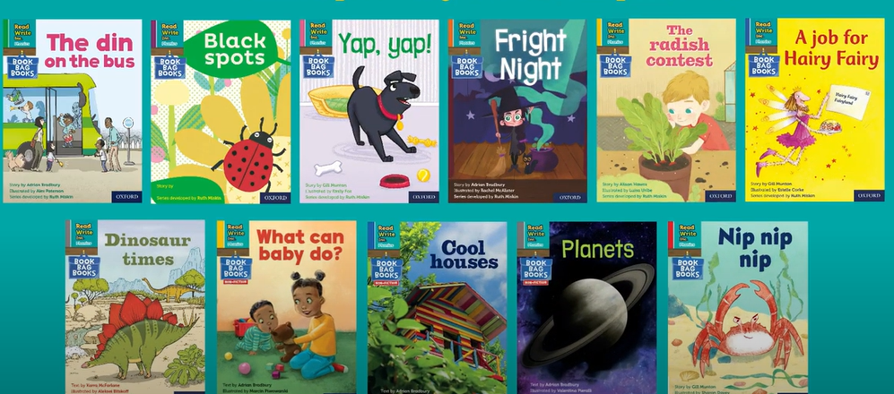
Any other questions
Q&A

