Slide 1
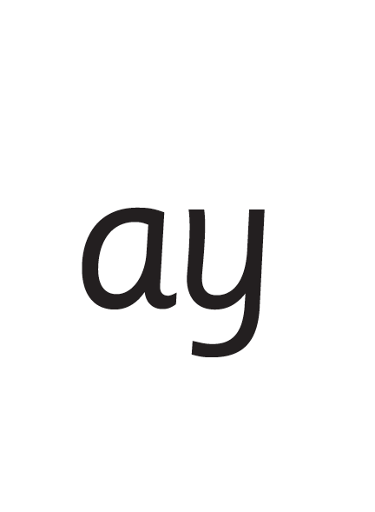
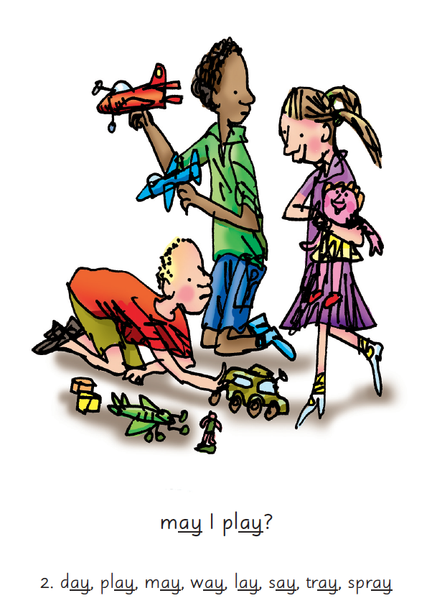



Reading and Phonics

Slide 2
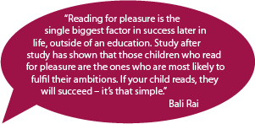
Research evidence - Benefits of reading for pleasure
There is a growing body of evidence which
illustrates the importance of reading for
pleasure for both educational purposes as
well as personal development (cited in Clark
and Rumbold, 2006).
Evidence suggests that there is a positive relationship between reading frequency, reading enjoyment and attainment (Clark 2011; Clark and Douglas 2011).
Reading enjoyment has been reported as more important for children’s educational success than their family’s socio-economic status (OECD, 2002).
Evidence suggests that reading for pleasure is an activity that has emotional and social consequences (Clark and Rumbold, 2006).
Other benefits to reading for pleasure include: text comprehension and grammar, positive reading attitudes, pleasure in reading in later life, increased general knowledge (Clark and Rumbold, 2006).
Children who are read one book a day will hear about 290,000 more words by age 5 than those who don't regularly read books with a parent or caregiver ( Ohio State University)

Slide 3
The importance of reading at Churchend
At Churchend Primary Academy we believe that reading is central to a child’s understanding of the school curriculum and is of vital importance in life. Fluent readers can access a full range of life experiences and can enjoy an amazing breadth of genres and writers.
At Churchend, we aim to develop a love and appreciation of reading which will stay with children for life. We achieve this through careful planning and teaching, with phonics teaching central to early reading acquisition .
We aim to use quality reading materials and resources within English lessons and guided reading sessions. We provide a breadth and range of reading material in school, including all genres of fiction, nonfiction, poetry, plays & pupils own writing.
We encourage children to select their own choice of reading materials and celebrate authors by all classes hearing daily stories read by adults which allow them to develop their vocabulary, understanding of characters and plot as well as just falling into an imaginary world.

Slide 4
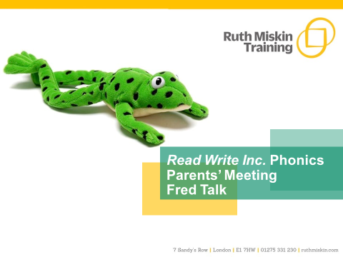
Read Write Inc. is a literacy programme developed by Ruth Miskin and is taught in over 5000 schools in the United Kingdom.
Read Write Inc (RWI) is a phonics programme which helps all children learn to read fluently and at speed so they can focus on developing their skills in comprehension, vocabulary and spelling. The programme is designed for children aged 4-7. However, at Churchend we begin the programme in Nursery and will continue teaching RWI to children beyond the age of 7 if they still need support in their reading.

Slide 5
What is phonics?
Sounds
Graphemes
https://schools.ruthmiskin.com/resources/watch/332/
Notes:
All words are made up of individual sounds. These sounds are merged together to form words.
e.g. in ‘mat’ we have the sounds ‘m’, ‘a’, ‘t’, ship – ‘sh’, ‘i’, ‘p’.
Click A grapheme is another name for the letters we use to write the sound. The spelling of that sound on the page.
Phonics is the method of teaching reading through the identification of sounds and graphemes.
The new National Curriculum ensures that all children are taught Phonics systematically.
This gives your children the tools to read any word.

Slide 6
Speed Sounds Set 1
Notes:
Remember that:
- Children need to know sounds – not letter names – to read words.
- We pronounce the sounds clearly, using pure sounds (‘m’ not’ muh’, ’s’ not ‘suh’, etc.) so that your child will be able to blend the sounds together to make words more easily.

Slide 7
Speed Sounds Set 2
Notes:
Set 2 sounds are shaded. They are long vowel sounds with 2 or more letters. We call these ‘Special Friends’ – two letters together that make one sound.
Let’s practise saying these sounds together.
Say each sound MTYT.
Once children know these Set 2 sounds, they know one way of reading and writing every sound.

Slide 8
Speed Sounds Set 3
Notes:
Once children know how to read Set 2 sounds, they start to learn Set 3 sounds.
These are shaded in the chart.
They are alternative graphemes (spelling of a sound) for the Set 1 and Set 2 sounds the children already know.
Point to the chart to show. For example, they know ‘ay’ and now learn a-e and ai as other spellings for the same sound.

Slide 9

Name the pictures
Notes:
We give children a hook to learn the sounds by using pictures in the same shape as the letter.
‘s’ looks like a snake.
‘d’ looks like a dinosaur.
‘m’ looks like a mountain.
‘a’ looks like an apple.
We teach the children to name the mnemonic pictures before they learn the sound.
This means that children learn to read and write the sounds really easily.

Slide 10

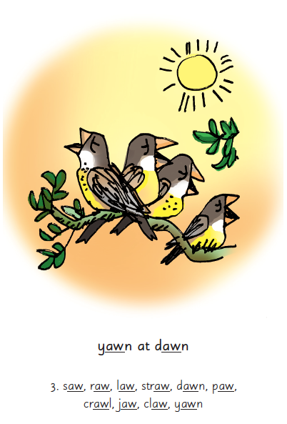
Picture Phrases
Notes:
We use picture phrases to help children remember the Set 2 and Set 3 sounds.
For example, ay, may I play? aw, yawn at dawn

Slide 11

Teaching letter formation
Notes:
Children use the picture mnemonic to learn to form letters correctly at the same time they learn to read each sound.
Each sound has a handwriting phrase e.g. down Maisie, and over the mountains.
Use these handwriting phrases when practising writing at home with your child.
Avoid using these to read the sound.
I will give you a handout of these handwriting phrases when you leave today.

Slide 12
What can I do?
1. Use pure sounds, not letter names
2. Teach the picture names
3. Practise reading sounds speedily -
‘review, review, review’
4. Use the handwriting phrases for writing only
Notes:
Show how to use ‘My Set 1 Speed Sounds Book 1’ or cards if you send these home.
You can purchase Set 1 flashcards or My Reading and Writing Kit ages 3-5 early sounds and blending to support your child with Set 1 sounds at home.

Slide 13

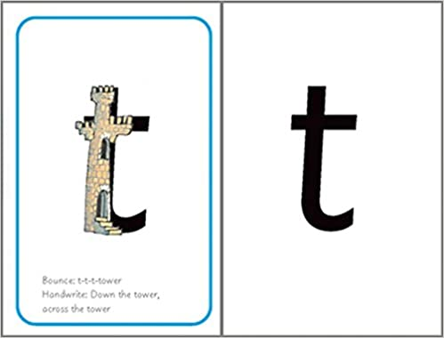

Sounds + blending = reading
+
+
Notes:
Today I want to help you understand how your child is learning to read words in Read Write Inc. Phonics by blending sounds together:
Alongside teaching children sounds, we teach them to blend sounds to read words e.g. s-a-t, sat.
We use Fred Talk to help children read.

Slide 14




Reading with Fred Talk
Notes:
We teach children to read words using Fred Talk to blend together the sounds they know e.g. m-a-t, mat.
We say ‘Fred Talk, read the word’.

Slide 15


‘Special Friends’, ‘Fred Talk’, read the word
Notes:
Then children practise reading these sounds in words using the routine ‘Special Friends’, ‘Fred Talk’, read the word’.
They spot the ‘Special Friends’ first, then Fred Talk to read the word.
For example, ‘ay’, s-p-r-ay, spray.

Slide 16

Fred Talk routine
Say the word in sounds as Fred e.g. c-a-t.
Ask your child to repeat. Can they ‘jump-in’ with the whole word?
Say the word in sounds followed by the whole word e.g. c-a-t, cat
Ask your child to repeat
Notes:
Fred Talk follows a consistent routine:
Say the word in sounds as Fred e.g. c-a-t. Ask children to repeat. Pause to allow children to ‘jump-in’ with the whole word.
Say the word in sounds followed by the whole word e.g. c-a-t, cat. Ask children to repeat.

Slide 17
Fred games and Fred talk throughout the day
l
-u
?
Shall we have some
What would you like to
Let’s put on your
-ch
-n
-ay
-l
p
?
-oa
-t
c
.
Notes:
Try to use Fred Talk throughout the day at home to help your child practise blending sounds together.
Fred Talk words at the end of the sentence and keep the words short and simple.
With the person next to you, have a practise of the three sentences on the screen.
Remember to Fred Talk the last word of the sentence.
You can also play Fred Games with your child at home. I will show you one of these in action in a moment,

Slide 18
Let's read it again and again!
At Churchend the children focus on one RWInc book for three or four days this allows different skills to be developed.
Read 1 focuses on accuracy, this stage takes lots of concentration!
Read 2 begins to develop fluency
Read 3 works on comprehension
Read 4 is for enjoyment
Notes:
In our school, children read each Read Write Inc. Storybook three times in class with their partner.
Re-reading the same book helps children to become confident readers. Each time they re-read, they build their fluency/speed and comprehension.
They love reading and want to read because they can read all of the words in the Storybook.
We set a focus for each re-read in school.
(Click) The first read focuses on reading every word accurately.
(Click) The second on reading the story more quickly.
(Click) The third read on comprehension - understanding what they read.
Then your child brings the same book home to read and enjoy with you again and again at home.
It’s ‘three with me, four at home.’
We do not send stories home the children cannot read because we always want them to be set up to succeed in their reading.
We want to make sure they enjoy reading so that they want to read.
The more they read, the faster progress they will make.

Slide 19

‘Special Friends’, ‘Fred Talk’, read the word
Notes:
E Children will be able to read all of the words in the Storybook.
If they hesitate, remind them to read the word using ‘Special Friends, Fred Talk, read the word’.
For example, this means they spot the ‘sh’, then Fred Talk and blend to read the word e.g. sh, sh-i-p, ship.

Slide 20

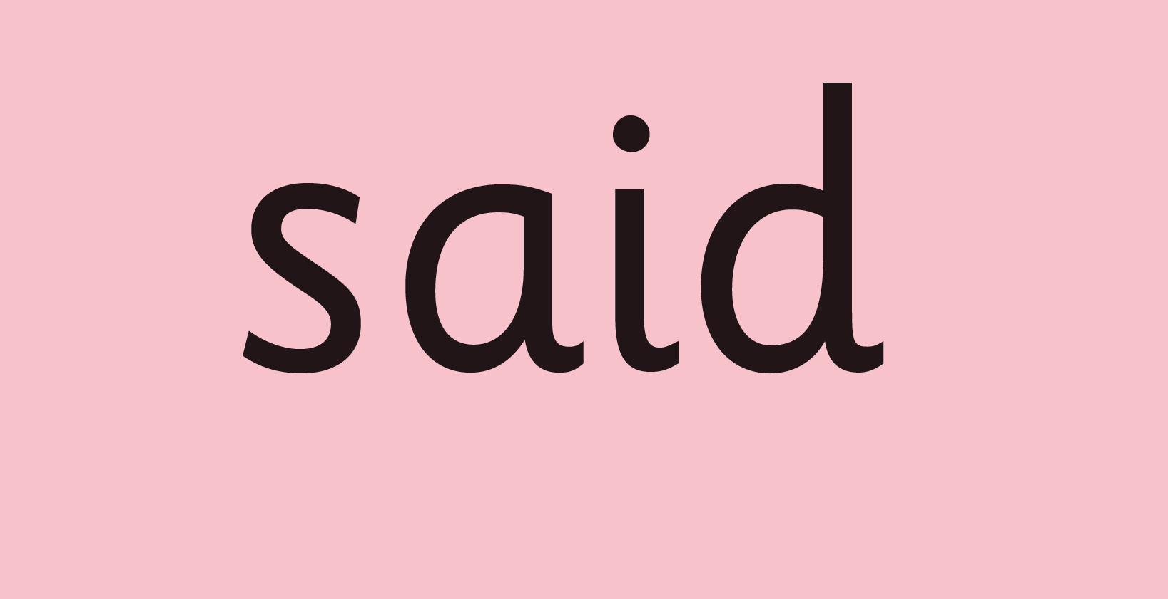
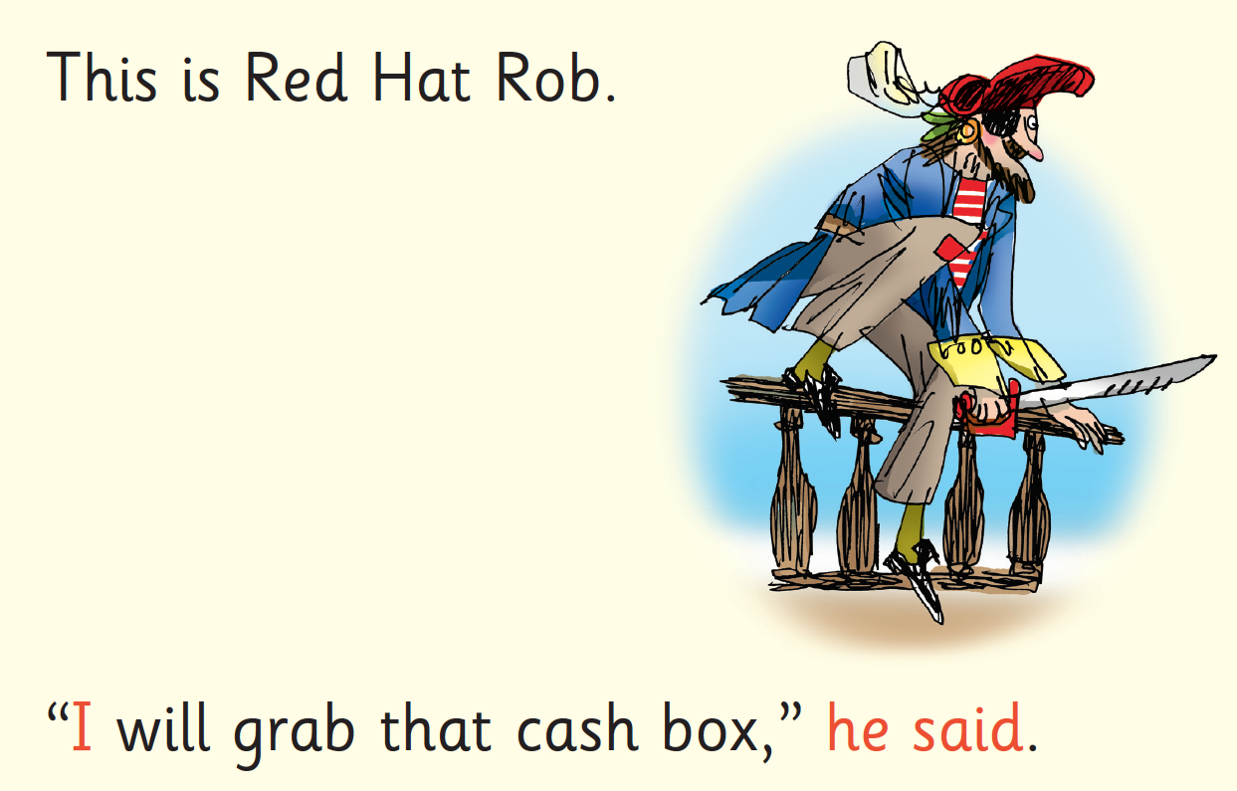
Red Words
Notes:
Some words are ‘tricky’ because they contain letters that don’t match the sounds the child has been taught.
For example, ‘said’ has ‘ai’ making an ‘e’ sound.
We teach these common exception words as Red words.
In the early Storybooks, these words are printed in red text.
Remind your child not to use Fred Talk to read Red words but instead to stop and think. Tell them the word if needed.

Slide 21
What can you do?
Listen to your child read the same Storybook again and again
Encourage them to use ’Special Friends’, ‘Fred Talk’, ‘read the word’
Discuss the story and encourage their storyteller voice.
Notes:
Provide copies of ‘Reading at Home Booklet 1 or 2’ from Oxford Owl.
Booklet 1 is sound groups and Ditty/ Red Groups and Booklet 2 for Green – Grey Storybooks.

Slide 22


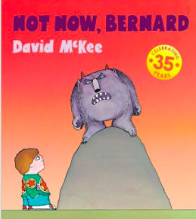

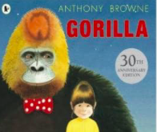
Repeated readings
Again! Again!
Children are wired to thrive on repetition
Notes:
Stories provide a wealth of language we don’t use in everyday talk.
The more stories, poems and nursery rhymes children know well, the more easily they will be able to understand what they read, when they can read.
Children thrive on repetition.
Take Sophie who is 2 ½ years old.
She begs for her favourite stories to be read over and over again.
The more her mum repeats the story, the more the story ‘belongs’ to Sophie.
Sophie ‘reads’ it, copying the special emphasis and actions that her mum used every time she read the story to her.

Slide 23
10 things your child learns when you read aloud stories and poems every day
Sustain attention
Appreciate rhythm and rhyme
Build pictures in their minds from the words on the page
Understand humour and irony
Use new words and phrases in different contexts - and later in writing
Learn new vocabulary and knowledge of the world
Think about characters’ feelings and use appropriate voices
Follow a plot with all its twists and turns
Understand suspense and predict what’s about to happen next
Link sentences and ideas from one passage to the next
Notes:
Look at all these things you child will learn when you read aloud stories and poems, - without any teaching!
Click each point and read.

Slide 24
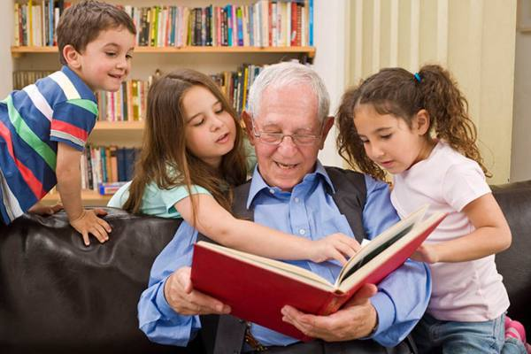


Top Tips - Storytime
Make it a treat
Make it a special quiet time
Show curiosity
Read story once without stopping
Chat about the story
Avoid testing with questions
Link to other stories and experiences
Read favourites over and over again
Use different voices
Love the book
Notes:
Here are our ten top tips for Storytime at home.
Make it a treat – introduce each new book with excitement.
Make it a special quiet time – cuddle up!
Show curiosity in what you’re going to read.
Read story once without stopping so they can enjoy the whole story. . If you think your child might not understand something say something like ‘Oh I think what’s happening here is that…”
Chat about the story e.g. I wonder why he did that? Oh no, I hope she’s not going to…
Avoid asking questions to test what they remember.
Link to other stories and experiences you have shared e.g. this reminds me of…
Read favourites over and over again – encourage your child to join with the bits they know. Avoid saying ‘not that story again!’
Use different voices – be enthusiastic!
Love the book – read with enjoyment.
I will give you a handout with these tips when you leave today.

Slide 25
What is the Phonics Screening Check?
A word-reading test at the end of Year 1
Children read 40 words
Cancellation of the phonics screening check in June 2021 means the year 2 pupils did not take the check in year 1. In the 2021 to 2022 academic year, it is statutory for schools to administer a past version of the phonics screening check to year 2 pupils during the second half of the 2021 autumn term and return results to their local authority.
The autumn check is intended to ensure that year 2 pupils who need support in learning to decode using phonics are not missed.
Year 2 pupils who meet the expected standard in phonics in the 2021 autumn check will not be required to complete any further statutory assessments in phonics. Year 2 pupils who do not meet the expected standard in the 2021 autumn check will be expected to take the statutory check in June 2022, alongside year 1 pupils.
Notes:
Children complete a word-reading check at the end of Year 1 so that parents can be confident their children are being taught to read successfully.
Children read 40 words. It takes between two and five minutes.
If they do not manage to read 32 of the words, they are given extra support, and repeat the check at the end of Year 2.
It means that all children will be able to read accurately before they begin Year 3.
In our school, we aim to make sure that every child learns to read accurately by the end of Year 1 so they are set up for success in school and in life.
As soon as we spot a child who needs extra practice learning to read sounds and words, we teach them one-to-one for a few minutes every day.

Slide 26
‘Special Friends’, ‘Fred Talk’, read the word
Notes:
We teach children to read both real and nonsense words using the routine ‘Special Friends’, ‘Fred Talk’, read the word’.
Children spot the ‘Special Friends’ (two letters that make one sound), Fred talk the word, and then read the word as a whole.
For example, ‘sh’, sh-i-p, ship.

Slide 27




Nonsense words
Notes:
Half of the words in the check are real words.
Half are nonsense words. For example, ‘sheb’, ‘glight’, ‘ched’, ‘teb’.
There is a picture of an alien next to each word to remind the children that it isn’t a real word.
Nonsense words check that children will be able to read sounds they know in unfamiliar words.
Children who can read nonsense words will, very soon, be able to read any new word – for example – gargantuan, flailing, raucous, anticipation;
Reading new words increases children’s vocabulary rapidly.

Slide 28
Online resources available
Ruth Miskin Parents’ Page:
http://www.ruthmiskin.com/en/parents/
Ruth Miskin Facebook:
https://www.facebook.com/miskin.education
Free e-books for home reading:
http://www.oxfordowl.co.uk/Reading/

Slide 29
The more that you read, the more things you will know. The more that you learn, the more places you’ll go!
Dr. Seuss
Notes:
In the words of Dr Seuss…read quote.
Good readers do well in school – and in life.
By listening to your child read, you are making sure they have the opportunity to practise and become a good reader quickly.
Remember that all parents have the power to change outcomes for their children.

Slide 30
Any other questions
Q&A

