Slide 1

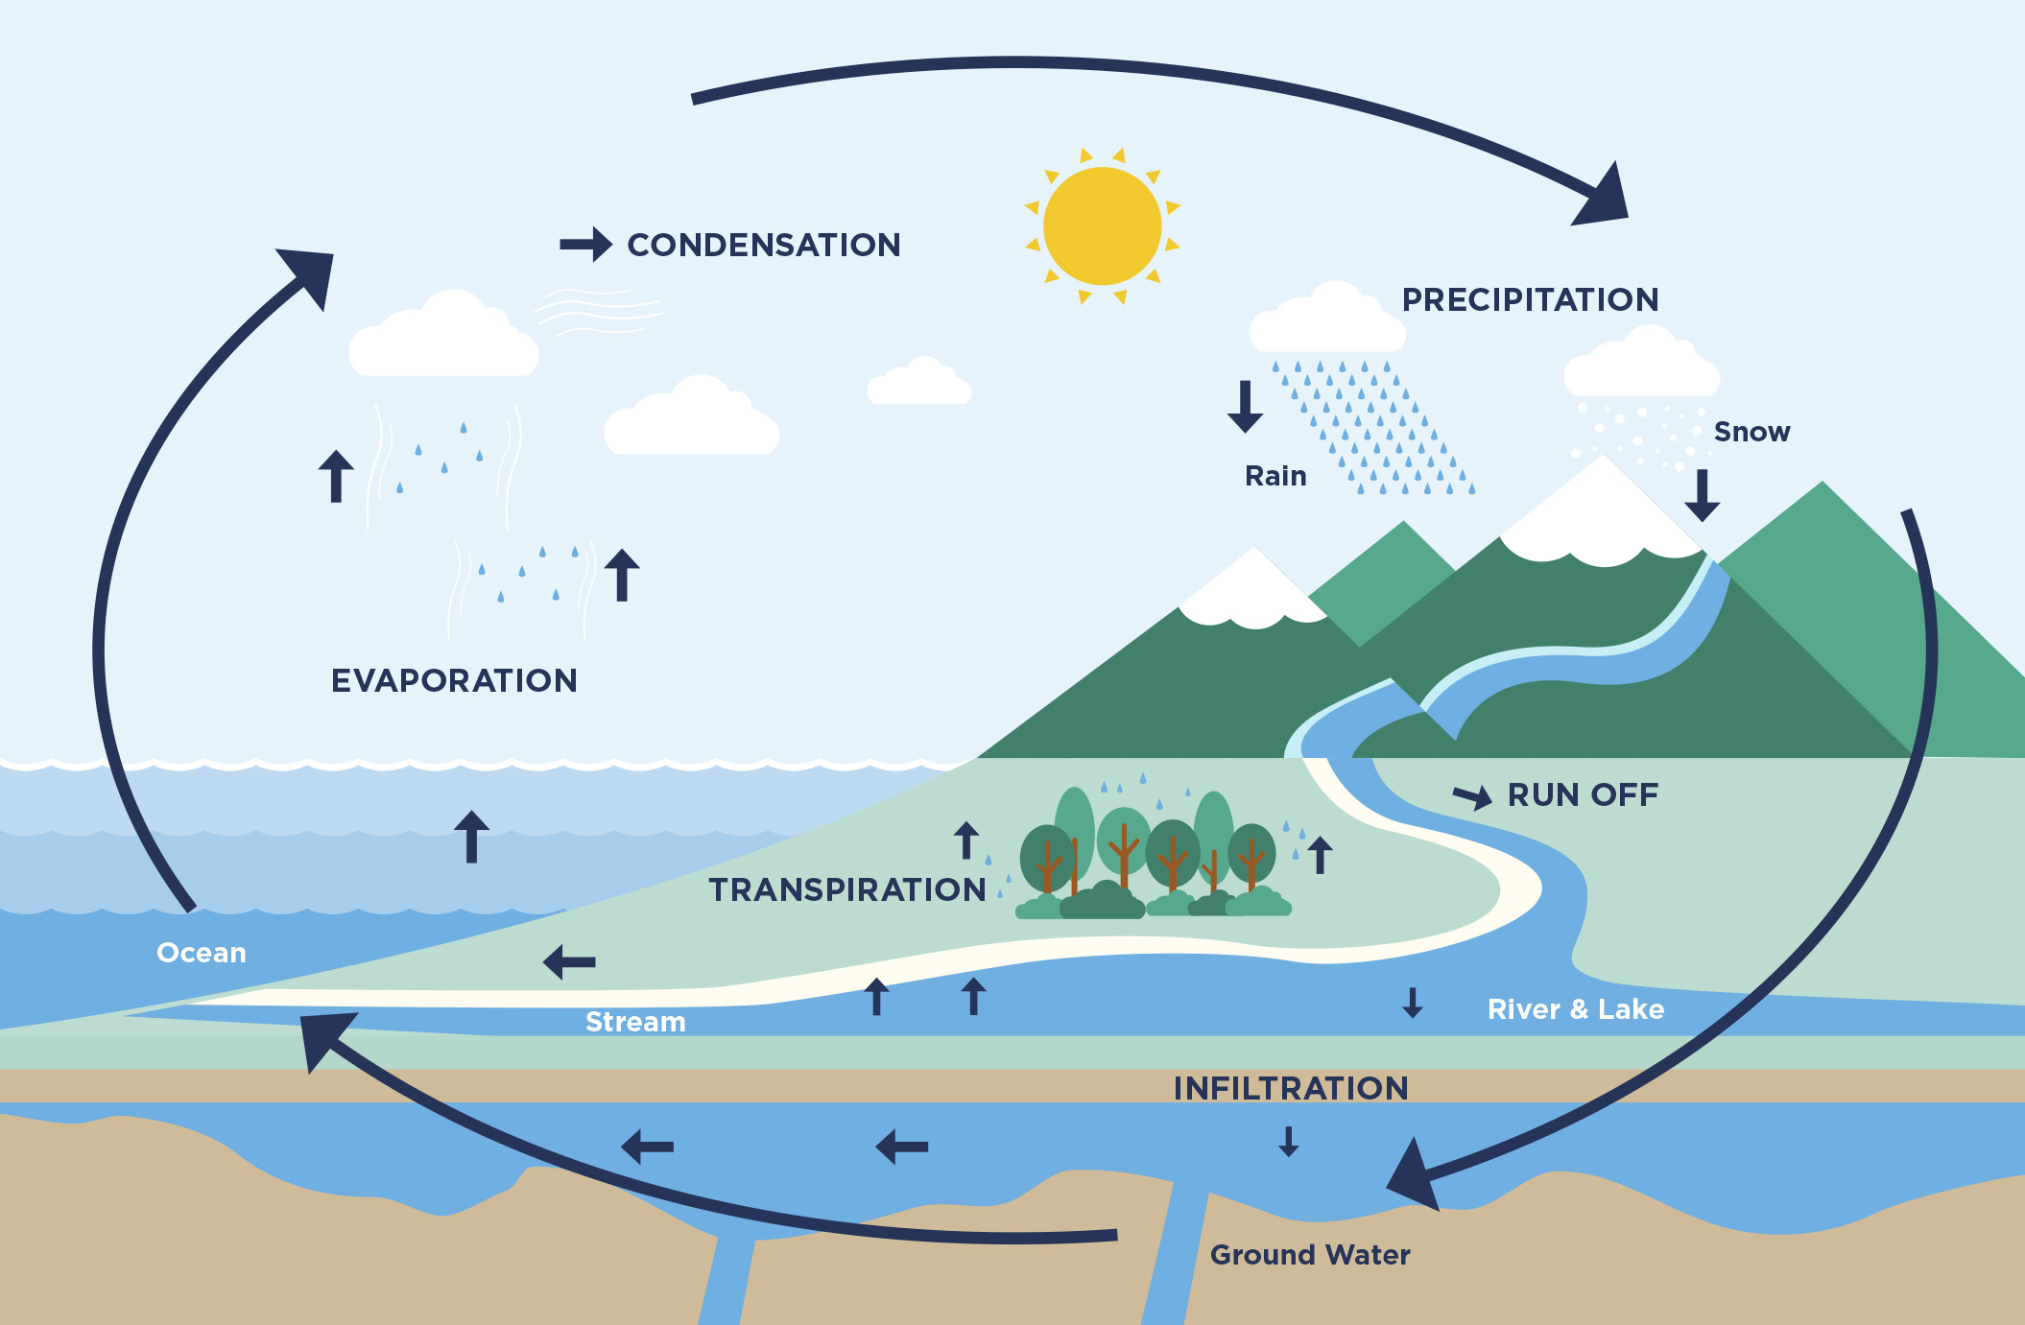
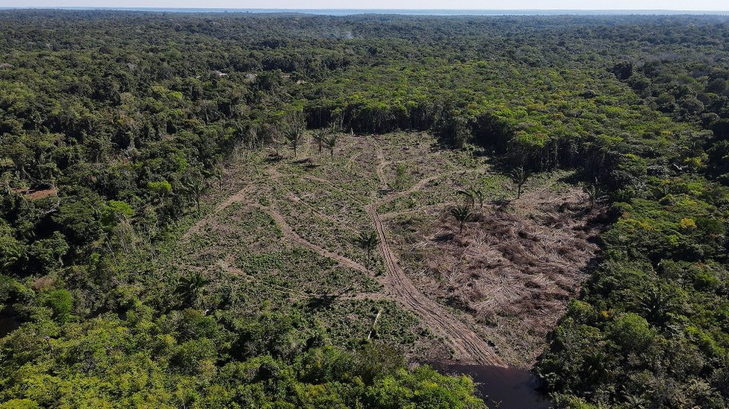
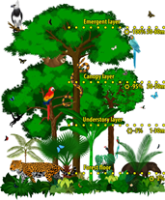
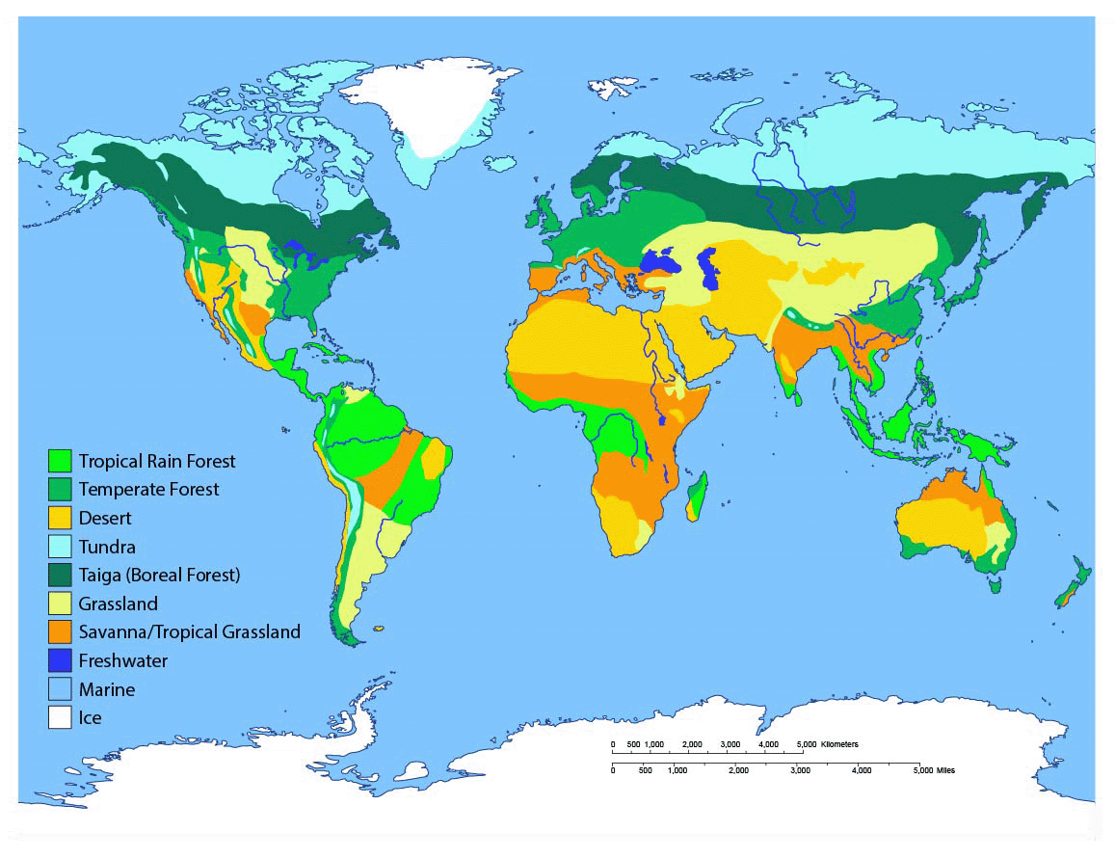
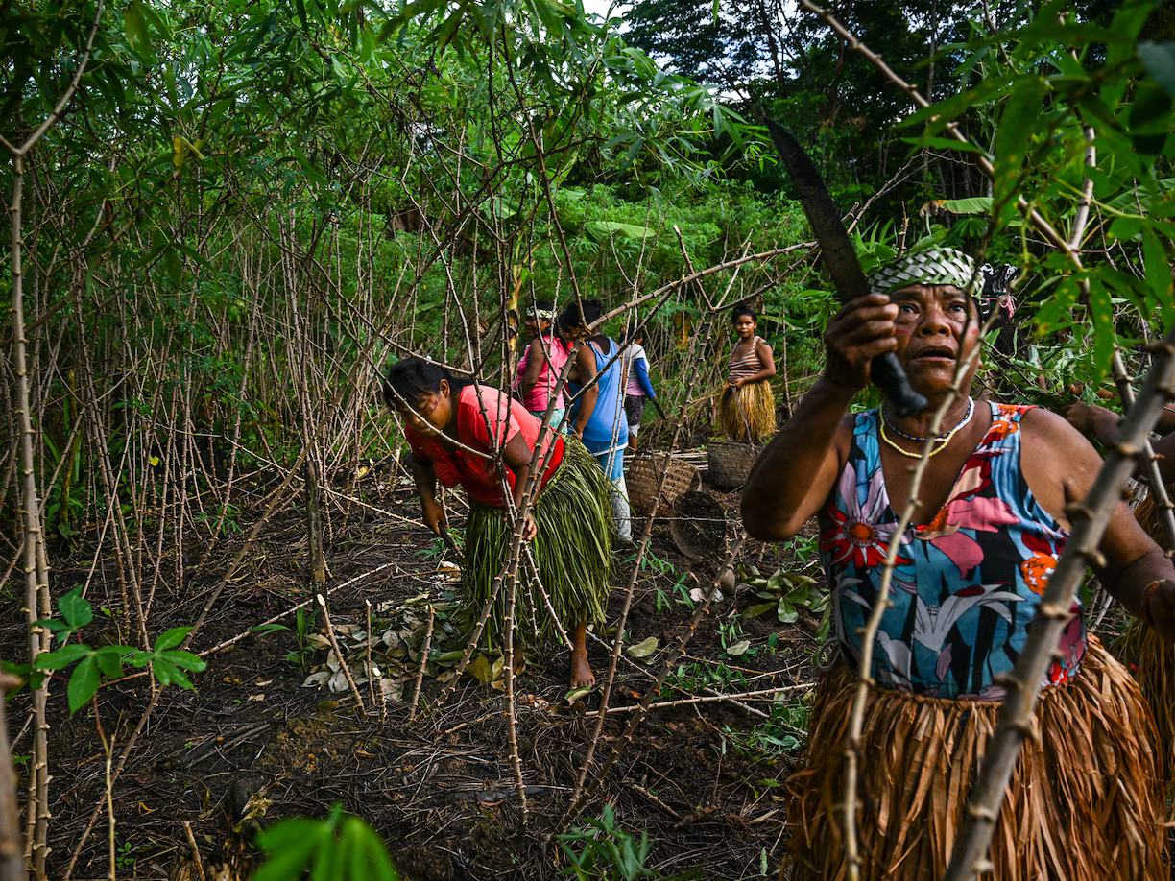
Geography – Rainforests – Responsibility| Year Five | Spring 1
Locational Knowledge
1 | Rainforests are usually found near the equator as the heat and the amount of trees speeds up the water cycle.
Human & Physical Geography
1 | The water cycle occurs in the rainforest but happens at a faster speed due to the increased amount of trees and transpiration.
2 | There are 6 major biomes: savannah, tundra, grasslands, rainforests, desert & woodlands.
3 | There are 4 layers in a rainforest: forest floor, understorey, canopy & emergent layer.
4 | There are tribes of people who live in the rainforest. These are called indigenous tribes.
5 | Rainforests are under threat due to deforestation & cattle farming.
Vocabulary
Hemisphere | The earth is divided in half at the equator. Each half is called a hemisphere.
Equator | A line drawn on maps to show the division between the north and south hemisphere.
Biomes | An area of the globe that has adapted to its climate and geographical features.
Rainforests | A luxuriant, dense forest rich in biodiversity, found typically in tropical areas with consistently heavy rainfall.
Transpiration | Water moving out of a leaf and into the air.
Indigenous | People original to a certain place.
Deforestation | The action of clearing lots of tress.
Place Knowledge
1 | The forests in the UK are different to rainforest in tropical countries.
Geographical Skills & Field work
1 | Use maps, atlases, globes and digital/computer mapping to locate countries and describe features studied

