Slide 1

Parent Information Meeting
Year

Slide 2

Welcome
Content:
Information
Communication
Curriculum
Policies
Expectations
Q&A

Slide 3
Housekeeping
Phones off/ on silent please
In the event of a fire, the exit door is at the back of the room.
The Fire Assembly point is in front of the main office, by the black fences.

Slide 4
Our Vision
THE BEST VERSION OF OURSELVES
Children are prepared for the next stage of their life.
Children to be happy and enjoy every aspect of their learning
Children have self-belief, confidence and seek new opportunities.
Children are resilient and independent learners.
Children are respectful members of their diverse community and make a positive contribution.
Children are curious, lifelong learners who maximise individual potential and are empowered to meet the challenges of a rapidly changing world.

Slide 5

Churchend Values

Slide 6



Our Behaviour Values
I am respectful
I am careful
I am responsible

Slide 7



Our Learning Values
I aim high
I am positive
I am resilient

Slide 8
Safety and Welfare
Safeguarding is the action that is taken to promote the welfare of children and protect them from harm
With safeguarding at the front of our mind, we would like to remind you of our access arrangements:
If your child is coming to breakfast club, or morning club such as judo or performance club, they will enter through the side door where a register is taken so we know who is on the school premises.
If your child is coming into school early for any other reason, please make sure your child enters school through the main office where the office staff will make sure they are registered.
We use a coloured lanyard system for all our adults in school (volunteers, staff, trades people, etc) so we know who has permission to be in school.
If you need to see your child's teacher, please book an appointment either with the office or arrange with your class teacher for a mutually convenient time. After school is preferable as in the morning, we want to avoid any delays in starting the school day.
Everyone has a responsibility to keep children and young people safe

Slide 9
Safety and Welfare
Safeguarding is the action that is taken to promote the welfare of children and protect them from harm
With safeguarding at the front of our mind, we would like to remind you of our access arrangements:
Please be aware that when wanting to speak to a teacher after school, you will need to wait until the class is dismissed.
Parents should not enter the school building unless they have a pre-arranged appointment or are accompanied by a member of staff.
May we remind you that the adventure playground is out of bounds before and after school and no-one should be on their scooters and bikes as they enter the school gates to avoid collisions.
Any emergencies or illnesses need to be recorded through the office.
Everyone has a responsibility to keep children and young people safe

Slide 10
Policies and Practices
Our behaviour strategy uses a therapeutic approach to behaviour with the aim of promoting positive behaviour. When necessary, we use a Behaviour Steps method to identify appropriate educational and protective consequences. Please see the website for more information.
All medication needs to go through the office where parents or carers will need to complete a medical consent form. We do keep certain medical equipment in the classroom for those children that have a medical plan.
We have a firm no bullying policy at Churchend Primary Academy. Please talk to your child’s teacher as the first port of call if any problems occur, so we can sort these out appropriately and in a timely manner.

Slide 11
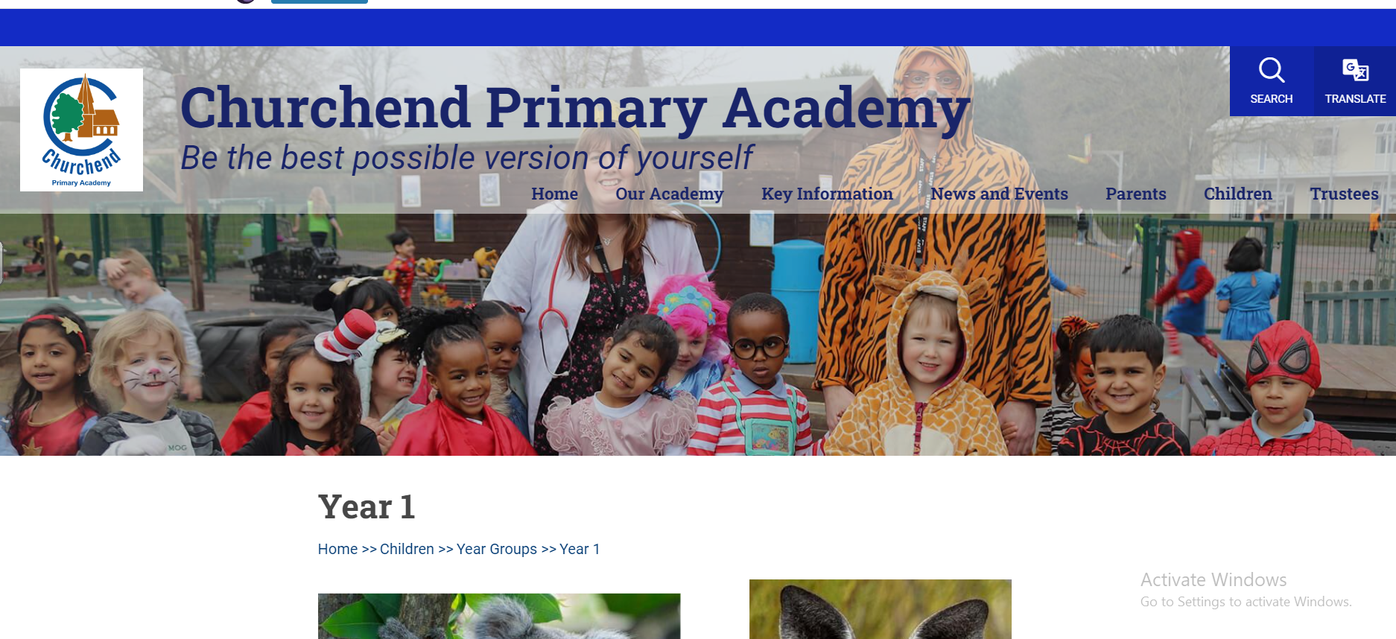
Communication
Our website
School text messages
Letters or Emails
Monthly School Newsletter from Mrs Slocombe
Parent Consultations - twice a year in the Autumn and Spring
Reports - Summer term
Informal -posters on the door
Class teacher – please speak to the class teacher about any concerns you have first.
Please try to put phones away and remove headphones when you pick your child up from school, they will be excited to tell you about their day.

Slide 12
Key Times of the School Day
8:35am School gates open.
8:45am No more entry via school gates as classroom doors are closed. Registration
8:50am School gates are closed.
8:55 -9:14am Children arriving after 8:55am and until 9:14am are marked as ‘Late’
9:15am Children arriving after this time is marked as ‘absent’ for the session. This is an unauthorised absence. NB:If the gates are closed and pupils are signed in in the school office, they are only marked as late after 8:55am/9.15am
3:15pm End of school day
3:40pm Children not collected by this time will be taken to our After School Club and will incur cost of the session.
Attendance matters – please bring your child on time to school every day!

Slide 13
Curriculum - English
We follow the National Curriculum for English
We use high quality texts and first hand experiences to inspire and learn writing skills.
Focus areas:
Handwriting is a consistent size.
Begin to join handwriting with correct diagonal strokes, at the end of Year 1.
Write narratives and from real life experiences
Write for different purpose Inc. poetry, instructions
Plan aloud, write and check their work
Write sentence-by sentence
Grammar focus areas:
Use terms noun, adjective.
Write statements, questions, commands, and exclamation
Expanded noun phrases

Slide 14

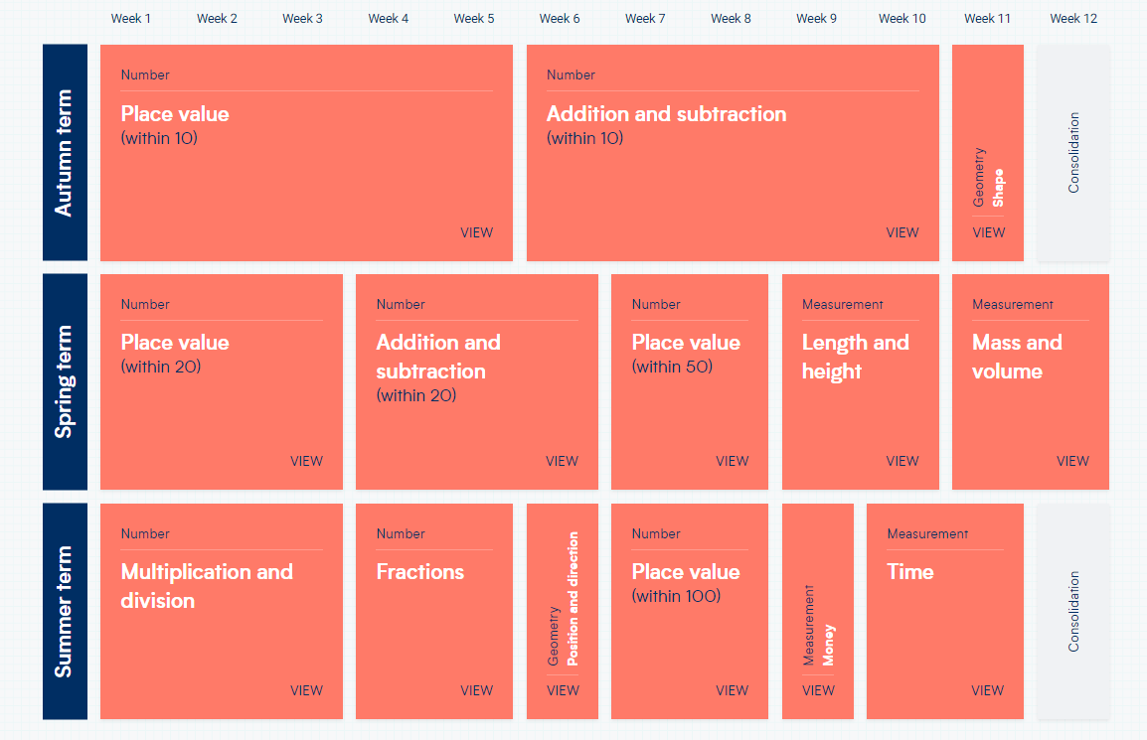
Curriculum - Maths
We follow the National Curriculum for Maths
We teach using the White Rose Maths scheme and resources, which sequences learning
Focus areas:
Place Value
Reading and writing numerals and number words
Fluent in addition/subtraction facts within 10
Add/Subtract across 10s boundary
Counting to 100
Number patterns
Add/subtract within 100
Early multiplication by grouping, and division by sharing
Precise language for 2D and 3D shapes

Slide 15

Read Write Inc - Phonics
Early reading skills are taught using the Read Write Inc (RWInc) synthetic phonics scheme.
RWInc is a phonics programme which helps all children learn to read fluently and at speed so they can focus on developing comprehension, vocabulary & spelling skills
Through daily lessons, children:
  learn 44 sounds and the corresponding letters/letter
  learn to read words using Fred talk and sound blending
  read from a range of storybooks and non-fictions books matched to their phonic knowledge
  develop comprehension skills in stories by answering ‘Find It’ and ‘Prove It’ discussion questions
Reading books are changed 2 times a week and are fully decodable.
Children may be given the same book more than once to re-read and develop their confidence and fluency.

Slide 16
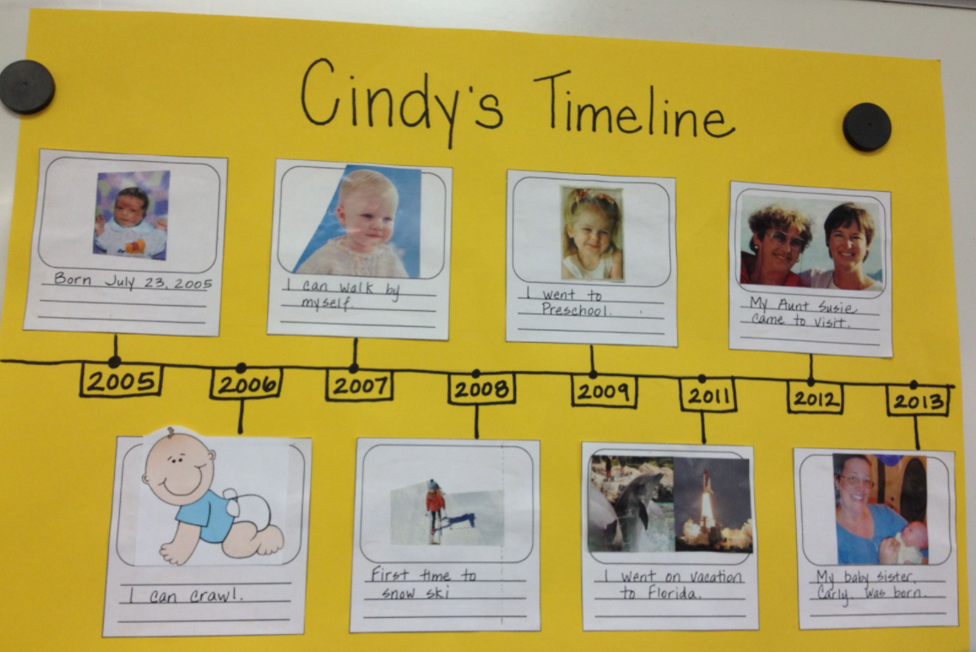


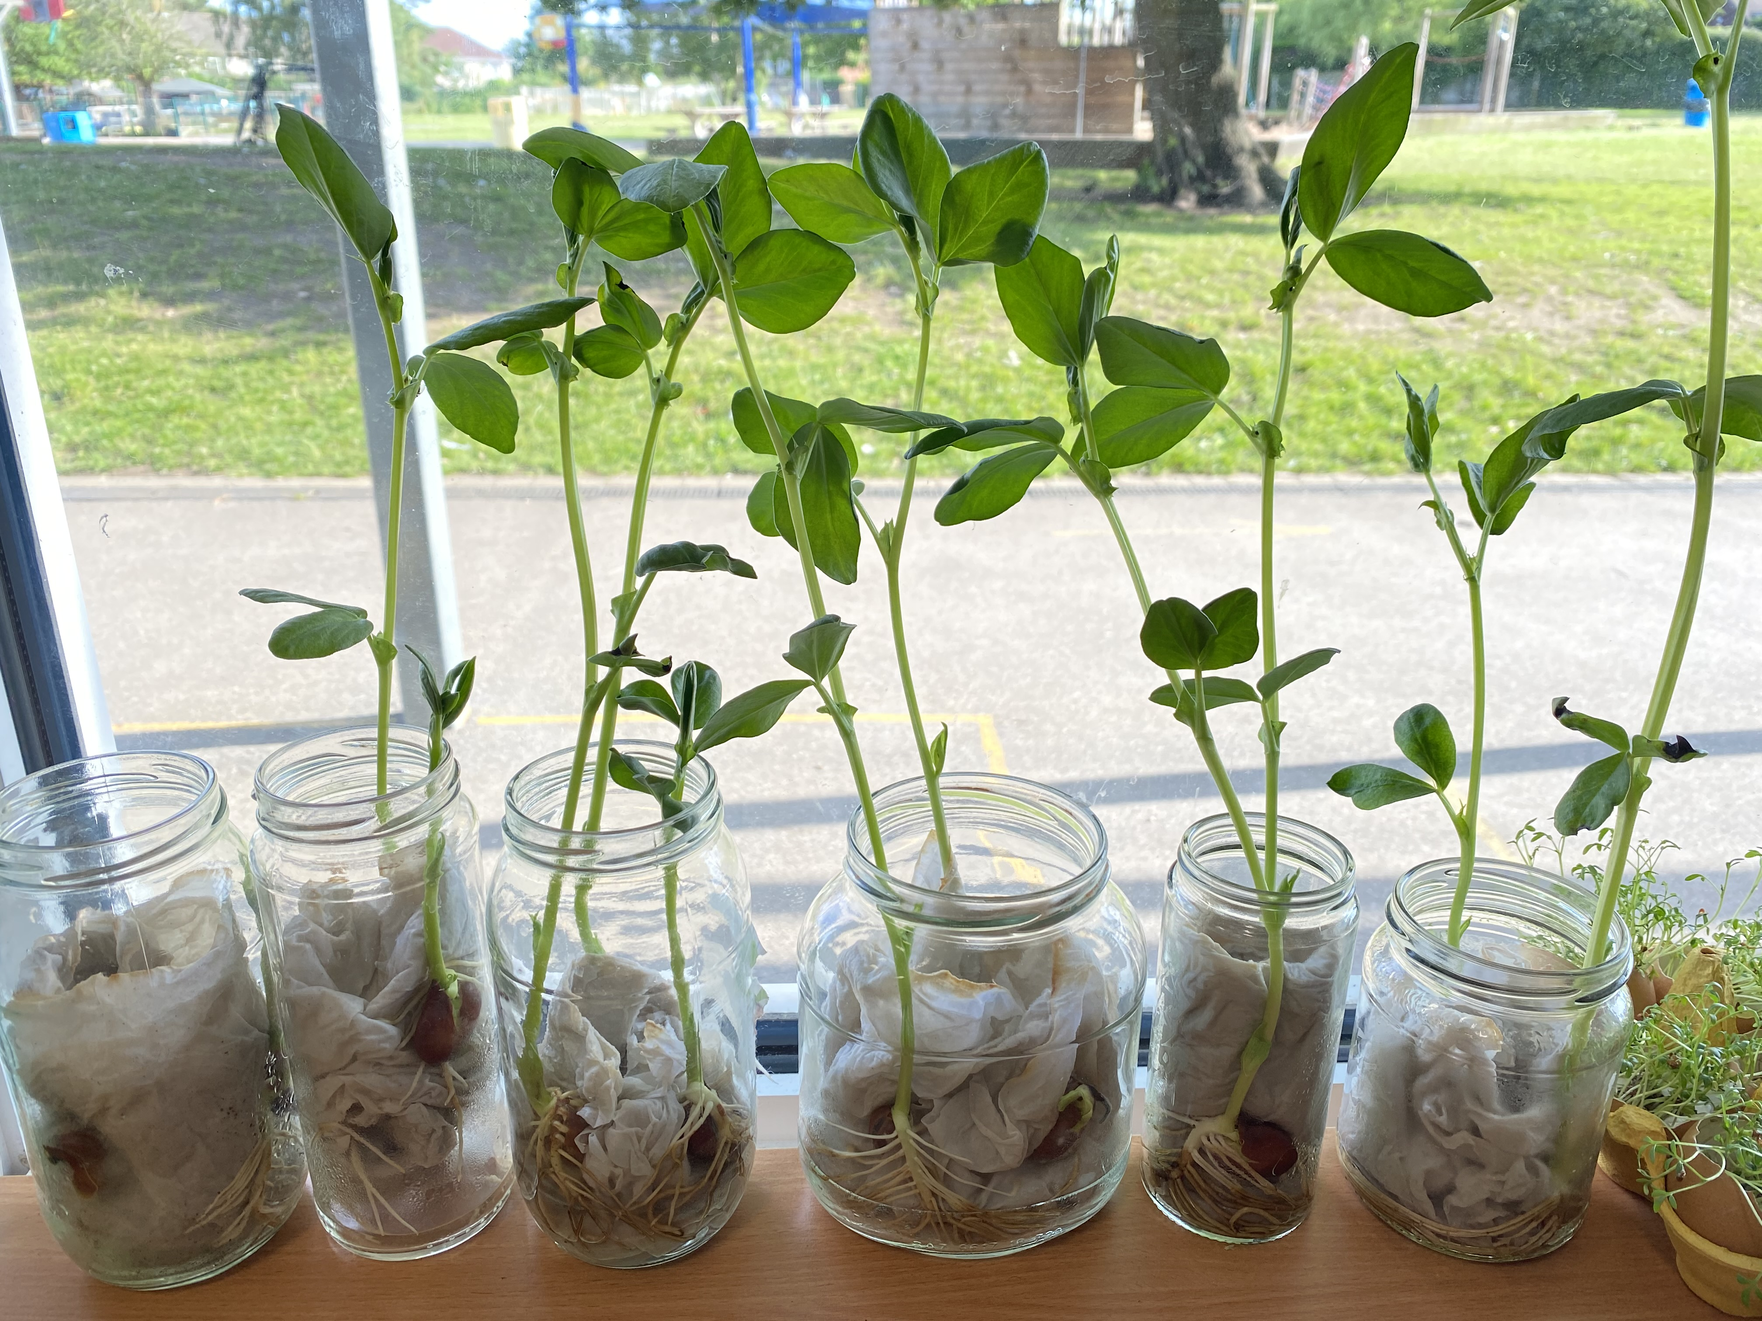
Science
We follow the National Curriculum for Science
Our Science topics include:
  Animals, including Humans
  Plants
  Use of everyday materials
  Seasonal changes (ongoing)

Slide 17

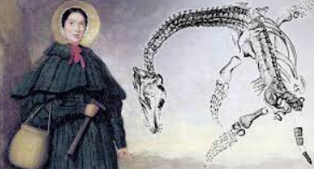
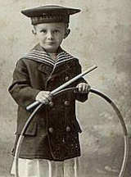
Broad and Balanced Curriculum
We follow the National Curriculum for all other subjects.
These include Geography, History, Art and Design Technology (DT).
Our topics include:
  Our Local Area
  Dinosaurs
  Australia
  Toys
We are currently planning some exciting educational trips this year to tie in with our curriculum. These include visits to XXXXXXXXX and XXXXXX.
We keep a careful eye on costings of visits to ensure we aren’t asking families to pay too much. All children are expected to attend the trip and if we do not receive enough funding, we may have to cancel the trip. Families can over-pay to support those families who struggle to pay. If you are struggling to pay, please speak to Mrs Baines via the school office.

Slide 18
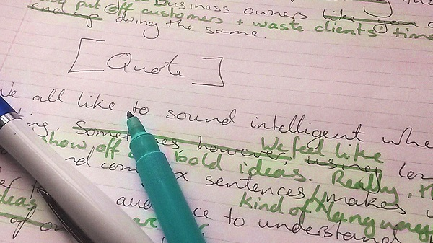
Feedback and marking
Feedback is intended to develop pupil independence.
This may be verbal or written and normally takes place during the lesson. Educational research shows feedback at the point of learning has the most impact on pupils’ work.
Pupils will make edits and correction to work in green pen.
Teaching Staff give written feedback in purple pen.

Slide 19
Assessment
Most assessment will be done every day through talking with the children and looking at their daily work.
A phonic assessment is completed every 6 weeks. Once children have completed the Reading Write Inc (RWInc) phonics scheme, a benchmarking system is used to assess decoding and comprehension skills.
Reading and maths skills are assessed against national curriculum standards using NFER tests 2 times a year. This helps us to assess if there are any gaps in learning and informs our planning.
There will be a Year 1 Phonics screening check before the end of the Autumn term. National assessments in Phonics take place in the summer term.

Slide 20
Expectations
We have high expectations of all children
Positive attitude
'Have-a-go' ethos
High expectations of attainment
Work independently
Take responsibility for their own learning and behaviour
Rewards
Follow the therapeutic behaviour approach and are often verbal. However, we do use a House system for rewarding good behaviour and learning and use this as a class reward. We also give out certificates and stickers.

Slide 21
Behaviour Expectations
We have high expectations of all children
As mentioned already, we use a therapeutic approach to behaviour which promotes positive behaviour.
We use a Behaviour steps method to support children when they have made a poor decision with regards to their behaviour. We use educational and protective consequences which supports them in making a better choice moving forward.
We will notify you where your child has made a poor choice and if necessary, ask you to meet with us to discuss next steps.
If relevant, we may ask Mrs Clark or Mrs Smithers to join us to best support your child.
We politely ask that you support us when we need to use an educational or protective consequence.

Slide 22






Taught and referred to regularly, across the school from the Summer Term in Reception.
Helps children to recognise, name and manage their emotions.
Based on 4 colours:
Children develop their own ‘toolkit’ of strategies to help them to return to ‘green’ where they are calm, happy and focussed.

Slide 23
Homework
Homework supports, extends and consolidates the learning covered in the classroom while supporting children to develop self- discipline.
We have based our Homework around learning key concepts in mathematics and English.
Please support your child and help them to establish a good routine. Please set aside a little time each day to complete the homework as little and often is best.
Reading is to be done daily. Books are changed on Fridays.
Log-ins for Times Table Rockstar/Numbots will be shared in the next week.

Slide 24
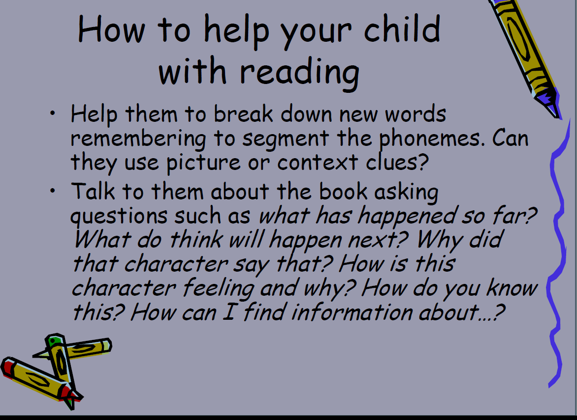

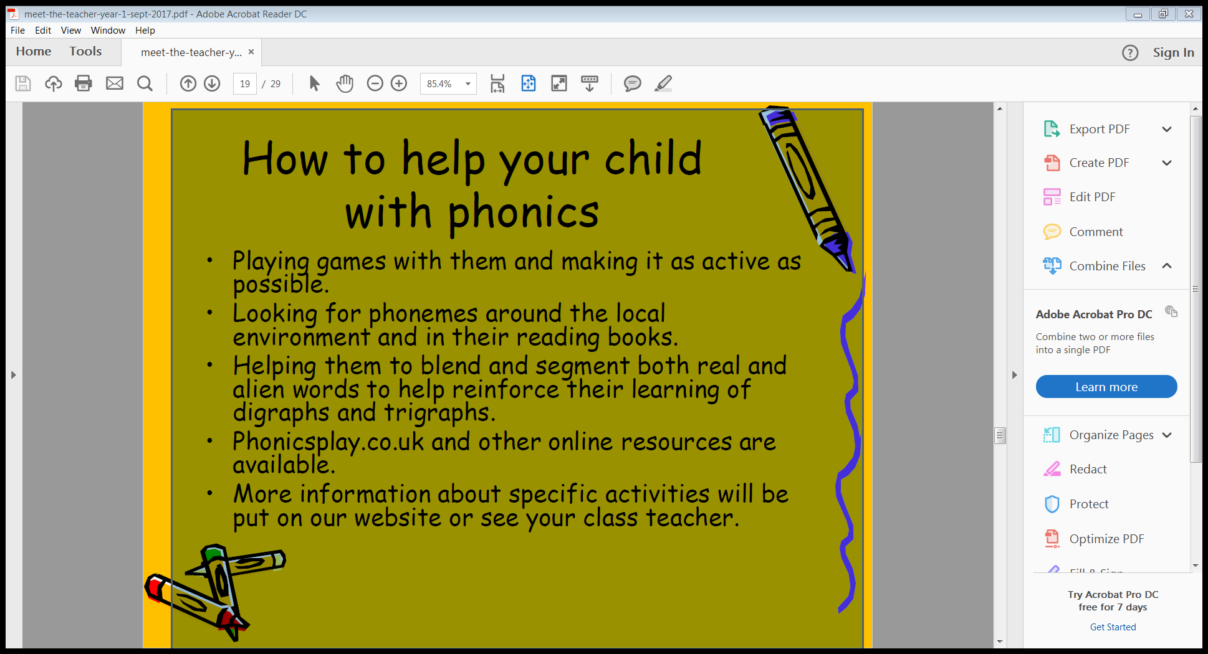

ruthmiskin.com/parents/
K

Slide 25
School Uniform
Uniform is an important part of the children’s learning as education equips them for future life. It links to our Behaviour Policy.
Please ensure your child comes to school every day in their full school uniform with black shoes and not trainers.
Long hair needs to be tied up with hair ties in the Academy colours (blue or gold).
The only jewellery the children are allowed are watches and stud earrings. Children at not allowed hooped earrings, bracelets or any other jewellery as this can become a health and safety issue. Children are also not to wear nail varnish.
Children will be allowed to come to school in their PE kits on their PE days; however, please ensure that their kit is in line with the Academy uniform policy of dark blue polo shirts and shorts or tracksuit bottoms with a plain navy sweatshirt / hoodie. Children are not to wear football tops, active wear or coloured tracksuits.
Nursey and Reception children need to come in their uniform every day and will get changed for their PE session in school as this is part of their developmental milestones.
Mrs Baines runs a second-hand uniform sale every half term and sells high quality uniform at a very low cost. Please make the most of these opportunities and never worry about coming to ask for uniform sooner if you need it.
A full list of the Academy uniform can be found under the parent tab on our website.

Slide 26
General Information
Uniform- please make sure this is labelled!
PE kit to include tracksuit and trainers with VELCRO unless able to tie laces.
Book bags and readers need to be in school every day.
Water bottles every day. Please do not send squash.
Sun hats and sun cream to be put on at home in the summer.
Volunteers - we always welcome volunteers to help with changing reading books and reading with the children. Please speak to the staff in the school office if you are interested so that relevant checks can be completed.

Slide 27
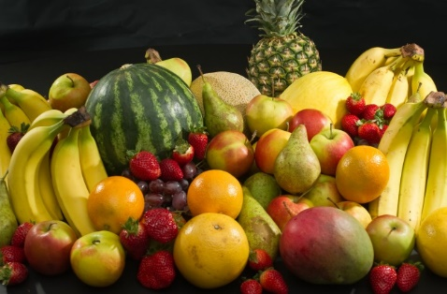
Snacks
There will be a piece of fresh fruit available each day for your child.
You are welcome to provide your own snack for your child, but please make sure it is a fruit or vegetable snack.
The same is expected if you send a packed lunch.
We are a no nuts school. This includes Nutella spread.

Slide 28

Parking
Regrettably there is no on-site parking for parents who drop off children for an 8:45am start.
The car park is for staff only. However, the left-hand gated car park can be used by parents who are dropping / collecting children who attend Breakfast or After School Clubs.
As with all schools, parking in local streets is very difficult at peak times.
Please respect the double yellow and zigzag line markings and also residents’ driveways along Usk Road in order to keep all children safe.
Where possible, we encourage families to walk/scoot or cycle to school.

Slide 29
General
Please pre-order School dinners online. If forgotten, the children will be given tomato pasta.
If your child has a sickness bug including vomiting, please keep them off for 48hrs and let the office know.
If someone else is collecting your child, please inform us beforehand in person preferably, or by phone or email so we can release your child to their care safely.

Slide 30

Questions

