Slide 1





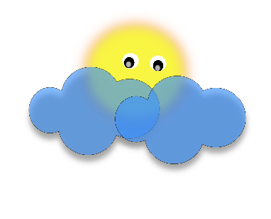

Churchend Primary Academy
Wonderful Me

Slide 2




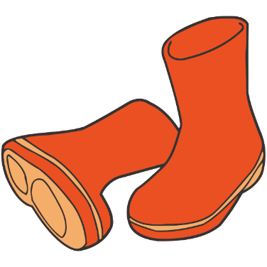
Early Years Foundation Stage
The Early Years Curriculum is split into 7 main areas.
3 Prime areas and 4 specific areas.
Prime Areas Specific Areas
Personal, Emotional and Social Development Literacy
Communication and Language Mathematics
Physical Development Expressive Arts and Design
Understanding the World

Slide 3

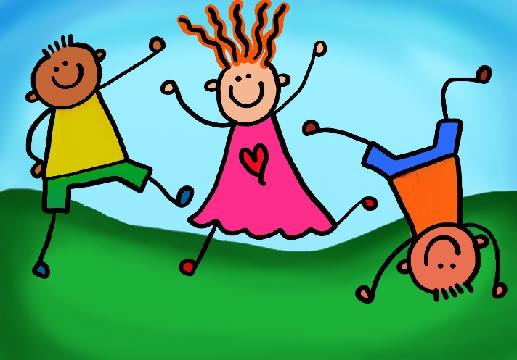
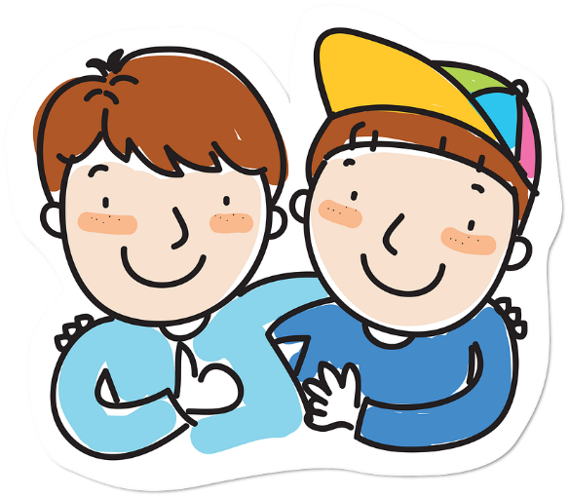
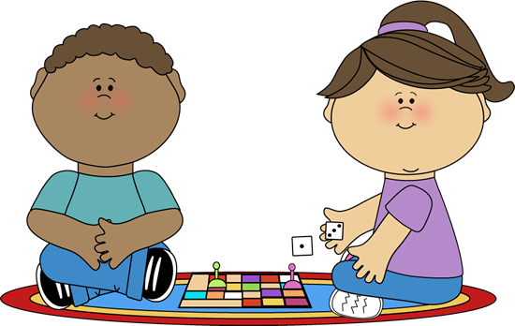
Personal Social and Emotional Development
I can say good bye to my main carer
I can follow some routines in the nursery
I know were to find my coat peg and hang up my coat
I can collect my lunch box and get ready for lunch
I can do some thing's on my own
I know how to ask for help if I need some
I have made some new friends and learnt their names
I can take my shoes and socks off and put them in my shoes
I can sit on the carpet and wait until my main carer collects me

Slide 4

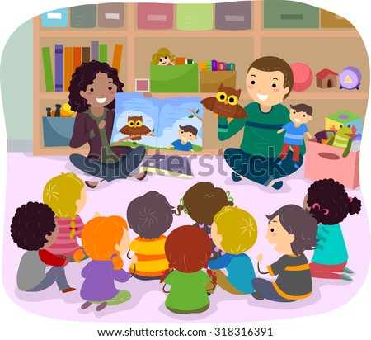
Communication and Language
  I can understand some instructions.
  I can point to objects.
  I can understand single words in context-run, milk, cat.
  I can listen to what people are saying.
  I can sing some nursery rhymes.
  I can tell you how I am feeling.
  I can sit and listen to a story.

Slide 5

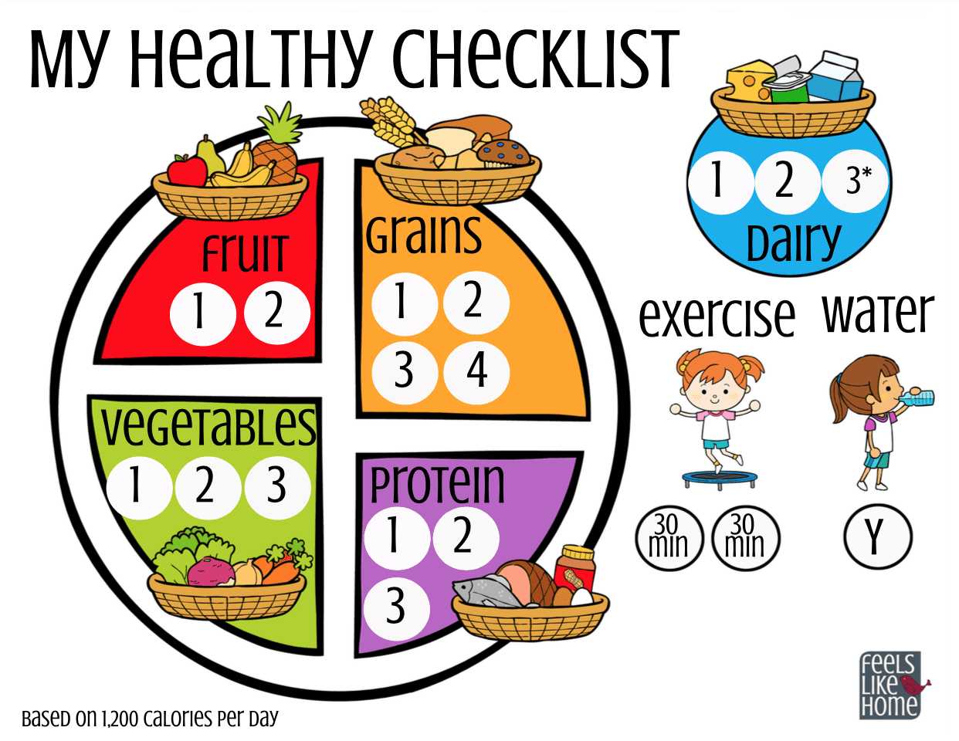
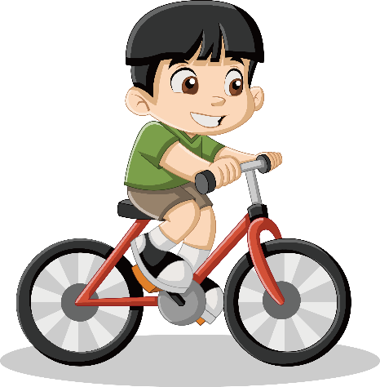
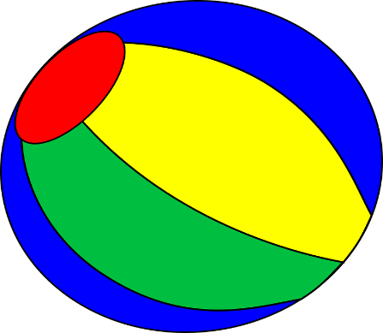
Physical Development
I can build with different resources.
I can clap and stamp to music.
I can sit on a bike and push with my feet.
I can use my large and small motor skills to do things.
I can feed myself
I can learn to use the toilet with help, and then independently.

Slide 6
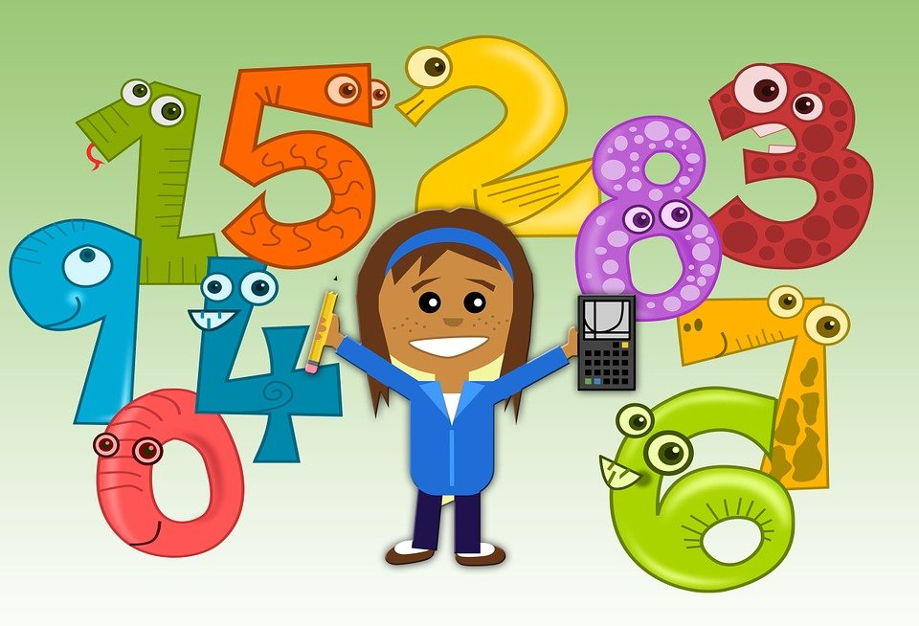

Specific Areas
Literacy
I enjoy sharing books with an adult.
I have favourite books and seeks them out to share.
Add some marks to drawings and I enjoy drawing freely.
I can repeat words and phrases from familiar stories.
Mathematics
I can build with a range of resources.
I can complete inset puzzles.
I can count in everyday context sometimes skipping numbers 1-2-3…-5.
I can count when I am singing number songs.

Slide 7
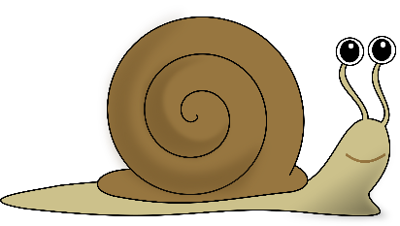
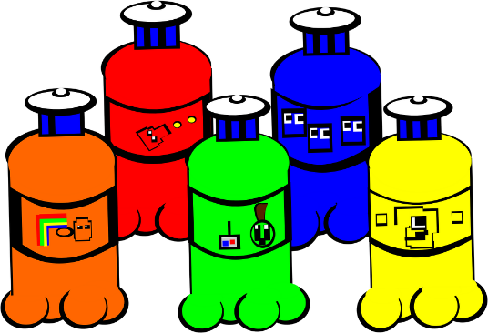
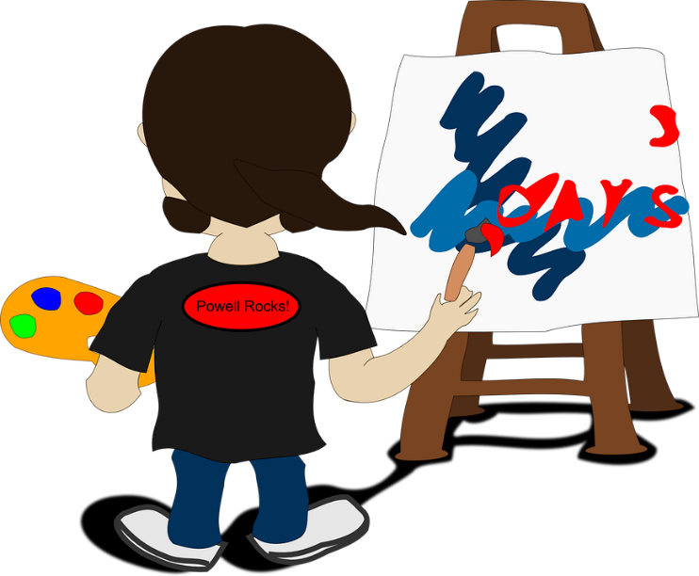
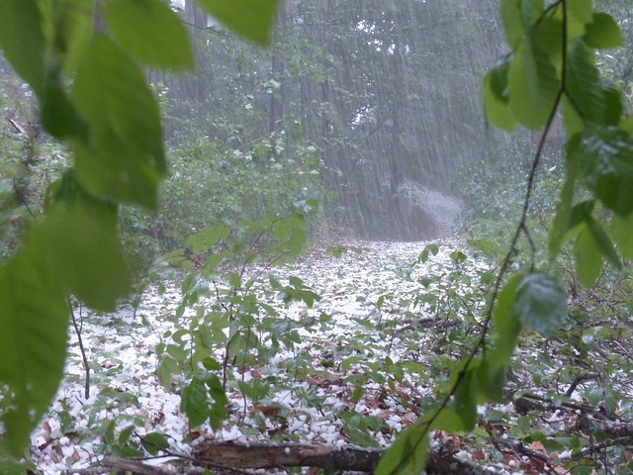
Specific Areas
Expressive Art and Design
I can explore paint using my fingers and other parts of my body as well as brushes and other tools.
I can express ideas and feelings through making marks, and sometimes give a meaning to the marks.
Understanding the World
I can explore and experiment with different materials.
Make connections between the features of my family and other families .
I can find my way to the hall and to the outdoor area.
I can explore in different weathers.

