Slide 1

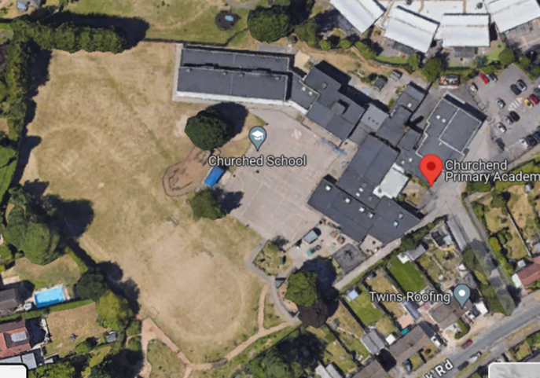
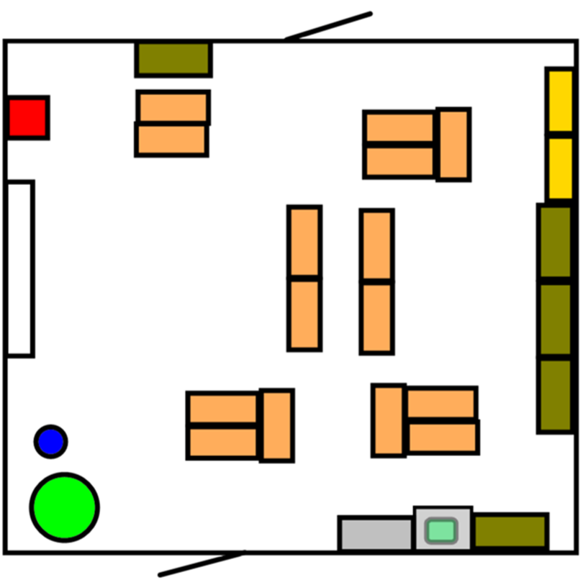
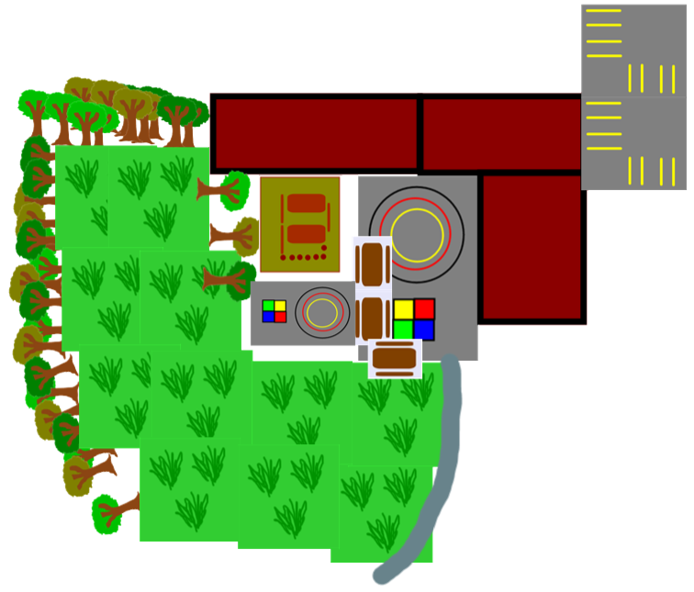
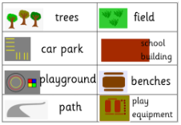
Geography – Our Local Area – Belonging| Year 1 | Autumn 1
Locational Knowledge
1 | Tilehurst is in Reading, in the South of England.
Human & Physical Geography
1 | Use basic geographical vocabulary to refer to key human features: town, countryside, village, farm, shop, house/flat.
2 | Use basic geographical vocabulary to refer to key physical features: lake, tree, bridge, river, mountain.
Vocabulary
Geography | Geography is the study of the world all around us and why it is like it is.
Fieldwork | Going out to a real place to see what is there.
Town | Where a few thousand people live together. It is bigger than a village but smaller than a city.
Bird’s eye view | The view when we are looking down from above.
Plan | A “bird’s eye view” of an indoor space.
Map | A “bird’s eye view” of an outdor space.
Human features | Something geographical that is man made.
Physical features | Something geographical that is natural.
Symbols | Simple shapes used to represent real things on a map or plan.
Key | A list of words to explain symbols on a map or plan.
Place Knowledge
 | Tilehurst is part of Reading town.
 | Reading is in England.
 | Tilehurst has shops, schools, offices, parks, houses and flats.
Geographical Skills & Field work
1 | Understand the different between a birds’ eye and side view.
2 | Use a key to identify features on a map.
3 | Locate Tilehurst on a map.
4 | Use aerial photographs to identify human features.

