Slide 1

Parent Information Meeting
Year 6

Slide 2

Welcome
VA
Content:
Information
Communication
Curriculum
Policies
Expectations
SATs
Secondary School
Q&A

Slide 3
Housekeeping
VA
Phones off/ on silent please
In the event of a fire, the exit door is at the back of the room.
The Fire Assembly point is in front of the main office, by the black fences.

Slide 4
Our Vision
CR
THE BEST VERSION OF OURSELVES
Children are prepared for the next stage of their life.
Children to be happy and enjoy every aspect of their learning
Children have self-belief, confidence and seek new opportunities.
Children are resilient and independent learners.
Children are respectful members of their diverse community and make a positive contribution.
Children are curious, lifelong learners who maximise individual potential and are empowered to meet the challenges of a rapidly changing world.

Slide 5

Churchend Values

Slide 6



Our Behaviour Values
I am respectful
I am careful
I am responsible

Slide 7



Our Learning Values
I aim high
I am positive
I am resilient

Slide 8
Safety and Welfare
VA
Safeguarding is the action that is taken to promote the welfare of children and protect them from harm
With safeguarding at the front of our mind, we would like to remind you of our access arrangements:
If your child is coming to breakfast club, or morning club such as judo or performance club, they will enter through the side door where a register is taken so we know who is on the school premises.
If your child is coming into school early for any other reason, please make sure your child enters school through the main office where the office staff will make sure they are registered.
We use a coloured lanyard system for all our adults in school (volunteers, staff, trades people, etc) so we know who has permission to be in school.
If you need to see your child's teacher, please book an appointment either with the office or arrange with your class teacher for a mutually convenient time. After school is preferable as in the morning, we want to avoid any delays in starting the school day.
Everyone has a responsibility to keep children and young people safe

Slide 9
Safety and Welfare
VA
Safeguarding is the action that is taken to promote the welfare of children and protect them from harm
With safeguarding at the front of our mind, we would like to remind you of our access arrangements:
Please be aware that when wanting to speak to a teacher after school, you will need to wait until the class is dismissed.
Parents should not enter the school building unless they have a pre-arranged appointment or are accompanied by a member of staff.
May we remind you that the adventure playground is out of bounds before and after school and no-one should be on their scooters and bikes as they enter the school gates to avoid collisions.
Any emergencies or illnesses need to be recorded through the office.
Everyone has a responsibility to keep children and young people safe

Slide 10
Policies and Practices
CR
Our behaviour strategy uses a therapeutic approach to behaviour with the aim of promoting positive behaviour. When necessary, we use a Behaviour Steps method to identify appropriate educational and protective consequences. Please see the website for more information.
All medication needs to go through the office where parents or carers will need to complete a medical consent form. We do keep certain medical equipment in the classroom for those children that have a medical plan.
We have a firm no bullying policy at Churchend Primary Academy. Please talk to your child’s teacher as the first port of call if any problems occur, so we can sort these out appropriately and in a timely manner.

Slide 11
Communication
VA
Our website
Letters or Emails
Monthly School Newsletter from Mrs Slocombe
Parent Consultations - twice a year in the Autumn and Spring
Reports - Summer term
Informal - morning messages and conversations at dismissal
Class teacher – please communicate with the class teacher about any concerns you have first.
Please try to put phones away and remove headphones when you pick your child up from school, they will be excited to tell you about their day.

Slide 12
CR
Key Times of the School Day
8:35am School gates open.
8:40am Morning task – arithmetic skills
8:45am No more entry via school gates as classroom doors are closed. Registration
8:50am School gates are closed.
8:55 -9:14am Children arriving after 8:55am and until 9:14am are marked as ‘Late’
9:15am Children arriving after this time is marked as ‘absent’ for the session. This is an unauthorised absence. NB:If the gates are closed and pupils are signed in in the school office, they are only marked as late after 8:55am/9.15am
3:15pm End of school day – children are allowed to walk home by themselves as long as the school has written permission.
3:40pm Children not collected by this time will be taken to our After School Club and will incur cost of the session.
Attendance matters – please ensure your child is on time to school every day!

Slide 13
Curriculum - English
CR
We follow the National Curriculum for English
We use high quality texts and first hand experiences to inspire and learn writing skills.
Focus areas:
Creative and extended writing
Grammar and Spellings
Master readers
If your child is reading a book in school, please can you try to avoid watching the film at home until we have finished
Grammar focus areas:
Consolidation of previously learned grammar
Punctuation to include colons, semicolons and parenthesis
Complex sentences
Active and passive voice

Slide 14

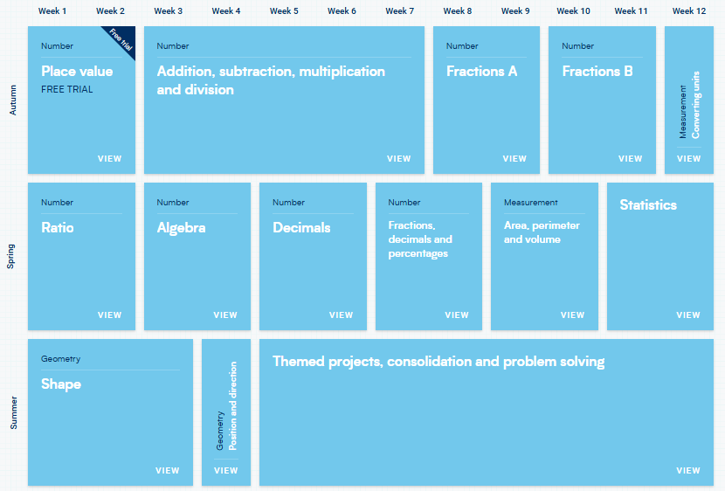
Curriculum - Maths
VA
We follow the National Curriculum for Maths
We teach using the Oak National Academy & White Rose Maths scheme and resources, which sequences learning
Focus areas:
Four operations including long multiplication and division
Fractions, decimals, percentages
Ratio
Algebra
Area, perimeter and volume
Revising content from the whole key stage
Problem solving

Slide 15
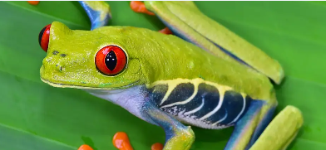

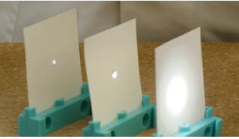
Science
CR
We follow the National Curriculum for Science
Our Science topics include:
  Living things and their habitats - classification
  Energy - light and reflection
  Evolution
  Animals including humans – including the circulatory system

Slide 16
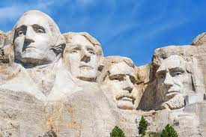
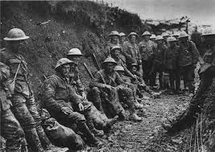

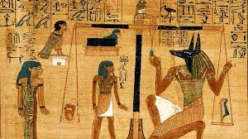

Broad and Balanced Curriculum
VA
We follow the National Curriculum for all other subjects.
These include Geography, History, Art and Design Technology (DT).
We keep a careful eye on costings of visits to ensure we aren’t asking families to pay too much. All children are expected to attend the trip and if we do not receive enough funding, we may have to cancel the trip. Families can over-pay to support those families who struggle to pay. If you are struggling to pay, please speak to Mrs Baines via the school office.
North America
WW1
Japan & Earthquakes
Egyptians
Computing
Systems & Networks
History of Computers
Programming
Creating a product
Data Handling
RE
Islam
Christianity
(likely to visit Mosque & Church)
PSHE
Economic Wellbeing
Family & Relationships
The Changing Body
MFL - Spanish

Slide 17
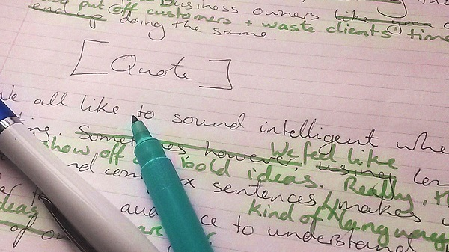
Feedback and marking
CR
Feedback is intended to develop pupil independence.
This may be verbal or written and normally takes place during the lesson. Educational research shows feedback at the point of learning has the most impact on pupils’ work.
Pupils will make edits and correction to work in green pen.
Teaching Staff give written feedback in purple pen.

Slide 18
Assessment
VA
Children complete assessments in Maths, Grammar & Reading every six weeks.
SATs will take place in May 2027 (Mon 10th- Thurs 14th)
  Attendance is vital.
  Maths x 3, Reading, Grammar & Spelling
  Preparation is thorough and supported.
  Special arrangements eg. extra time
  Marked externally.
  Results are reported in summer report.
  Early Breakfast

Slide 19
Expectations
VA
We have high expectations of all children
Positive attitude
'Have-a-go' ethos
High expectations of attainment
Work independently
Take responsibility for their own learning and behaviour
Rewards
Follow the therapeutic behaviour approach and are often verbal. However, we do use a House system for rewarding good behaviour and learning and use this as a class reward. We also give out certificates in Golden assembly and both classes have a soft toy!

Slide 20
Behaviour Expectations
CR
We have high expectations of all children
As mentioned already, we use a therapeutic approach to behaviour which promotes positive behaviour.
We use a Behaviour steps method to support children when they have made a poor decision with regards to their behaviour. We use educational and protective consequences which supports them in making a better choice moving forward.
We will notify you where your child has made a poor choice and if necessary, ask you to meet with us to discuss next steps.
If relevant, we may ask Mrs Clark or Mrs Hardy Bates to join us to best support your child.
We politely ask that you support us when we need to use an educational or protective consequence.

Slide 21






CR
Taught and referred to regularly, across the school from the Summer Term in Reception.
Helps children to recognise, name and manage their emotions.
Based on 4 colours:
Children develop their own ‘toolkit’ of strategies to help them to return to ‘green’ where they are calm, happy and focussed.

Slide 22
Homework
VA
Homework supports, extends and consolidates the learning covered in the classroom while supporting children to develop self- discipline.
We have based our Homework around learning key concepts in mathematics and English.
Please support your child and help them to establish a good routine. Please ensure your child is completing their homework to the standard expected in class.
Reading is to be done a minimum of three times a week (15-30 minutes per session). Books are changed when the book is finished.
Log-ins are stuck in the inside cover of reading records.
The majority of Maths homework will be set on maths.co.uk. If they have forgotten their logins, they can be reissued. If your child has an issue logging on, please let us know so we can make other arrangements.
Homework will be sent home on a Wednesday, and due on the following Tuesday. For the first few weeks, we will be writing a letter to the class. They will need to reply in the appropriate form – handwritten, correctly laid out with engaging language.

Slide 23
School Uniform
CR
Uniform is an important part of the children’s learning as education equips them for future life. It links to our Behaviour Policy.
Please ensure your child comes to school every day in their full school uniform with black shoes and not trainers.
Long hair needs to be tied up with hair ties in the Academy colours (blue or gold).
The only jewellery the children are allowed are watches and stud earrings. Children at not allowed hooped earrings, bracelets or any other jewellery as this can become a health and safety issue. Children are also not to wear nail varnish.
Children will be allowed to come to school in their PE kits on their PE days; however, please ensure that their kit is in line with the Academy uniform policy of dark blue polo shirts and shorts or tracksuit bottoms with a plain navy sweatshirt / hoodie. Children are not to wear football tops, active wear or coloured tracksuits.
Mrs Baines runs a second-hand uniform sale every half term and sells high quality uniform at a very low cost. Please make the most of these opportunities and never worry about coming to ask for uniform sooner if you need it.
A full list of the Academy uniform can be found under the parent tab on our website.

Slide 24
General Information
CR
Uniform- please make sure this is labelled!
PE kit to include tracksuit and trainers with VELCRO unless able to tie laces.
Book bags and readers need to be in school every day.
Water bottles every day. Please do not send squash.
Sun hats and sun cream to be put on at home in the summer.
Volunteers - we always welcome volunteers to help with changing reading books and reading with the children. Please speak to the staff in the school office if you are interested so that relevant checks can be completed.

Slide 25
Snacks
VA
You are welcome to provide your own snack for your child, but please make sure it is a fruit or vegetable snack.
The same is expected if you send a packed lunch.
We are a no nuts school. This includes Nutella spread/ Kinder Bueno/ Chocolate filled pancakes etc. PLEASE CHECK!!
Please discourage visits to the shop before school. No sweets at any time, or crisps outside of their lunch box.

Slide 26

Parking
CR
Regrettably there is no on-site parking for parents who drop off children for an 8:45am start.
The car park is for staff only. However, the left-hand gated car park can be used by parents who are dropping / collecting children who attend Breakfast or After School Clubs.
As with all schools, parking in local streets is very difficult at peak times.
Please respect the double yellow and zigzag line markings and also residents’ driveways along Usk Road in order to keep all children safe.
Where possible, we encourage families to walk/scoot or cycle to school.

Slide 27
General
CR
Please pre-order School dinners online. If forgotten, the children will be given tomato pasta.
We are a no nut school. If they bring a snack, please ensure it is a piece of fruit or vegetable.
If your child has a sickness bug including vomiting, please keep them off for 48hrs and let the office know.
If someone else is collecting your child, please inform us beforehand in person preferably, or by phone or email so we can release your child to their care safely.
No sweets or make-up in school – this includes lip gloss.

Slide 28
Looking forward in Year 6
VA
Residential Monday 19th – Friday 23rd October
WW1 Trip/ visitor tbc – Jan ’27
Post SATs trip – likely Paulton’s Park (Wed 19th May)
Bikeability level 3 – Summer Term (avoiding transition days
Leavers’ Play & Party – Thursday 8th July (Wed 7th – afternoon show)
Year 6 Park picnic – w/c 12th July
Leavers Assembly – 9.10am Final Day (Friday 16th July

Slide 29
Responsibilities
CR
In Year 6, children have many opportunities to take on extra responsibilities! There are many roles they may be able to take on, such as:
House Captain
School Council
Mini Police
Librarian
Eco-Champ
Assist in Early Years/ Assemblies / Office

Slide 30
Secondary School
VA
Applications on-line in October
Visit schools, look at web-sites, speak to staff eg SENCO
Choose for positive reasons!
In school preparation – summer term
Transition talks – May / June
Transition visits – July
Many schools now offer summer camps as part of transition
Develop independence this year

Slide 31

Questions

