Slide 1

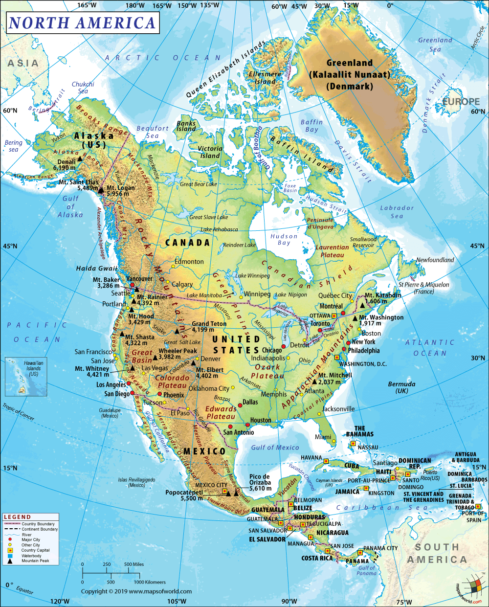
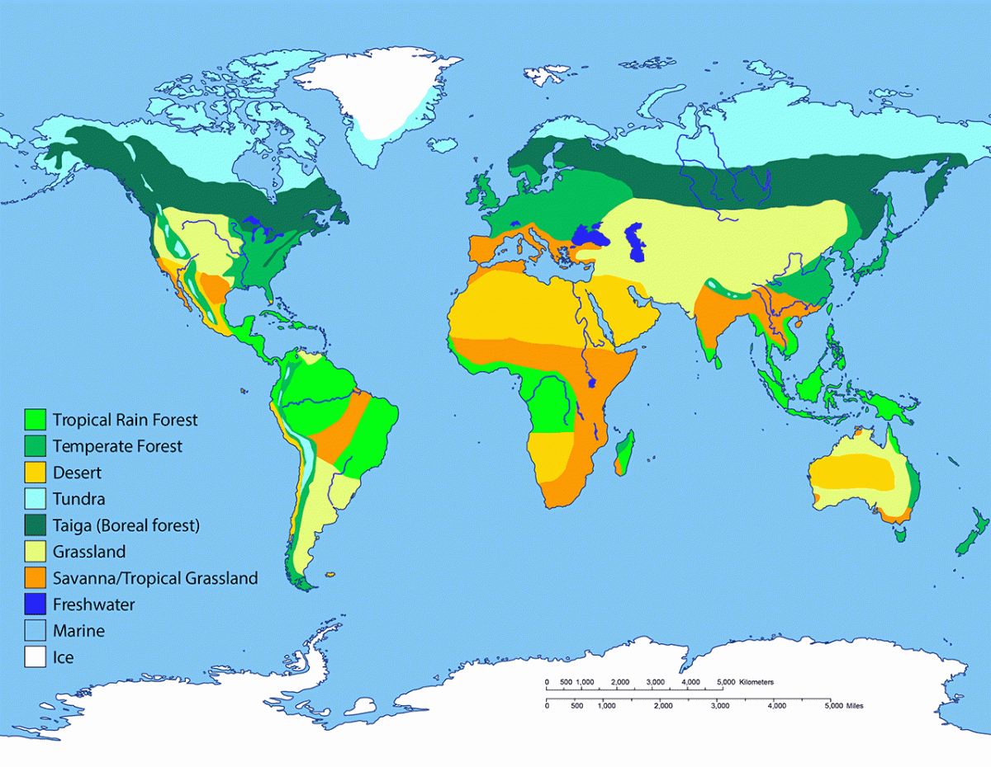
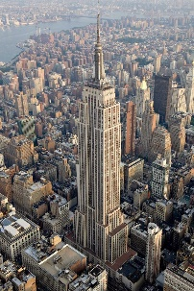
Geography – North America| Year Six | Spring 1
Human & Physical Geography
North America is home to many well known human geographical features such as the Statue of Liberty, the CN Tower and Chichen Itza.
The Rocky Mountains are North America’s largest chain. The Rockies stretch from the province of British Columbia, Canada, to the U.S. state of New Mexico.
The Mississippi River, at 3,730 kilometres (2,320 miles) long, is one of the longest river systems in the world and drains all or parts of 31 U.S. states.
North America can be divided into five physical regions: the mountainous west, the Great Plains, the Canadian Shield, the varied eastern region, and the Caribbean.
Within these regions are all the major types of biomes in the world. The biomes of the world are: tropical rainforest, temperate forest, desert, tundra, taiga, grassland, savannah, freshwater, marine and ice.
The world’s biomes are under threat due to a number of reasons linked to climate change and human behaviour. These include forest fires, rising sea levels and deforestation.
Vocabulary
Biome | A biome is an area classified according to the species (both plant & animal) that live in that location.
Climate change | Climate change refers to long-term shifts in temperatures and weather patterns, largely due to the burning of fossil fuels.
Climate zone | Areas with distinct climates, which occur in east-west direction around the Earth.
Deforestation | The removal of a forest or stand of trees from land that is then converted to non-forest use.
Grassland | Areas where the vegetation is dominated by grasses, often used for grazing.
Latitude | The angular distance of a place north or south of the earth's equator.
Longitude | The angular distance of a place east or west of the Greenwich meridian.
Savannah | A grassy plain in tropical and subtropical regions, with few trees.
Taiga | A biome characterized by coniferous forests consisting mostly of pines, spruces, and larches.
Temperate forest | A forest found between the tropical and taiga regions, located in the temperate zone.
Tropical rainforest | Rainforests that occur in areas of tropical rainforest climate in which there is no dry season
Tundra | A vast, flat, treeless Arctic region of Europe, Asia, and North America in which the subsoil is permanently frozen.
Locational Knowledge
North America is the third largest continent in the world. It is made up of 23 different countries and has a population of approximately 579 million people.
North America lies for the most part between the Arctic Circle and the Tropic of Cancer. The Tropic of Cancer and the Tropic of Capricorn are lines of latitude.
North America is bounded on the north by the Arctic Ocean, on the east by the North Atlantic Ocean, on the south by the Caribbean Sea, and on the west by the North Pacific Ocean.
The continent includes the enormous island of Greenland in the northeast and the small island countries and territories that dot the Caribbean Sea and western North Atlantic Ocean.
The continent is richly endowed with natural resources, including great mineral wealth, vast forests, immense quantities of fresh water, and some of the world’s most fertile soils.
Geographical Skills & Field work
Use a range of maps to describe the human and physical geography of North America.
Use 8 point compass to describe the location of an area/landmark.
Place Knowledge
Reading is a town in the English county of Berkshire. It has a population of 174,224.
Havana is the capital city of Cuba. It has a population of 2.13 million people.

