Slide 1



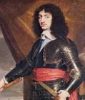
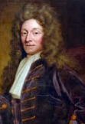
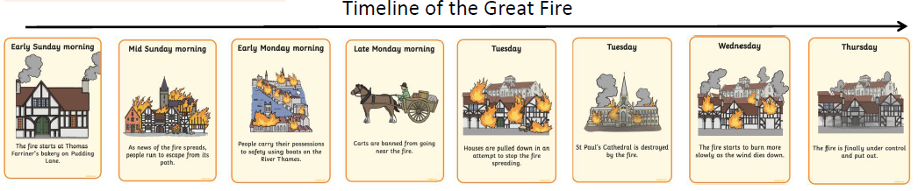
Vocabulary
Bakery | A place where bread and cakes are made and sold.
Alert | To make people aware of danger.
Douse | To put out a fire.
Extinguish | To put out a fire.
Ignite | When something catches fire.
Flammable | When something sets alight and burns easily.
Narrow | Small is width – opposite to wide.
Thatch | A roof covered with straw.
Eye-witness | Someone who sees an event with their own eyes and can describe it.
Diary | A personal record of life’s events.
Great Fire of London| Year Two | Autumn 2
Legacy
The Great Fire of London was a major fire that swept across London, for four days, from Sunday 2nd September to Thursday 6th September 1666.
The fire destroyed 13,200 houses, 87 parish churches, St Paul’s Cathedral and many other buildings.
The fire started in a bakery in Pudding Lane. A spark from the oven set the fire going.
London was rebuilt after the Great Fire. Houses were built out of stone and brick so that fires didn’t spread as easily.
New buildings were not allowed to have tops of their houses jutting out to avoid the spread of fire.
A monument was built on Pudding Lane to commemorate the fire and celebrate the rebuilding of the city.
After the Great Fire the first fire service was set up which later became the Fire Brigade.
Key People & Places
Thomas Farriner—owner of the bakery where the fire began.
Samuel Pepys—wrote a famous diary about the fire, which has given Historians a lot information.
King Charles II—the king of England at the time of the fire.
Sir Christopher Wren—a famous architect, who designed new buildings and a monument to the fire.

