Slide 1

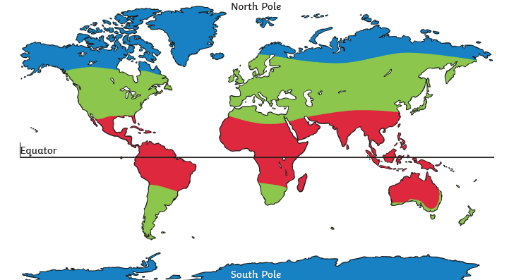
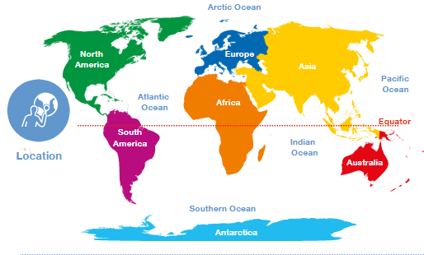
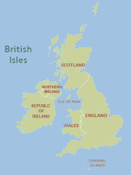
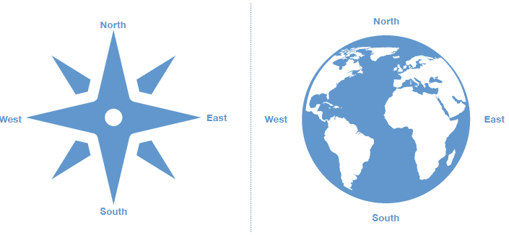
Geography – Our World – Belonging| Year Two | Autumn 1
Locational Knowledge
1 | The United Kingdom (UK) of Great Britain (England, Scotland, Wales) and Northern Ireland is made up of four countries.
2 | The world’s 7 continents North America, South America, Europe, Africa, Asia, Africa, Oceanian (Australia) and Antarctica.
3 | The world’s 5 oceans: Atlantic Ocean, the Indian Ocean, the Pacific Ocean, the Southern Ocean, and the Arctic Ocean
4 | Halfway between the North and South Poles is an imaginary line called the equator.
Human & Physical Geography
1 | Identify the location of hot and cold areas of the world in relation to the Equator [i.e. wet humid at equator, deserts above and below equator and cooling as areas become closer to poles; link to weather patterns in UK]
2 | Use of basic geographical vocabulary to refer to: Key physical features including: ocean, river, sea, coastline, mountain, cliff, valley, beach, forest, soil
Vocabulary
map | an image of an area of land or sea
equator | the imaginary line halfway between the North and South Poles and the Northern & Southern hemispheres
ocean | a large area of sea
channel | a length of water joining two larger bodies of water
union | joining together of different groups
compass | a device used to show direction on the face of the Earth
north, south, east, west | the four main direction points on a compass
climate | the weather conditions in an area
continent | a large area of land
hemisphere | half of the Earth, divided by the equator
Geographical Skills & Field work
1 | Use world maps, atlases and globes to identify the countries, continents and oceans studied [and their relative location to the UK].
2 | Use aerial images and plan perspectives to recognise landmarks and basic human and physical features.
3 | The Earth rotates (spins) on its axis. The Earth has two poles: the North and the South Pole.
4 | Use compass directions (north, south, east and west) to describe the location of different countries in relation to one another. Understand that north points to the North pole from any location on Earth.
Place Knowledge
1 | The capital cities and their human and physical features that we will teach of the four countries of the UK.

